Slide 1
Partnership for the Enforcement of European Rights PEER Regulatory Roundtable on Bundled Products Session 3: Bundled Products Complaints
CEER - Brussels
02.10. 2017
Cristina Portugal

Slide 2
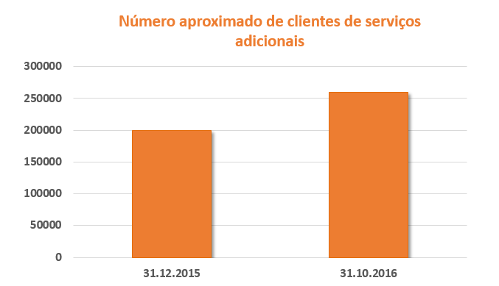
6 out of 18 operators propose Bundled or Additional Service Contracts
Number of clients growing (200.000 in December 2015 to 260.000 in October 2016)
Type of Bundled or Additional Service Contracts
Services (Insurance covering the payment of power bills in case of unemployment of the consumer; technical assistance and equipment maintenance services; energy consumption simulators)
Goods (cash or instalments/but not consumer credit): solar panels and other equipment
Discount on the price of electricity and gas is offered by 1 operator (10% E + 5% G)
Cost of services between €1.20/month to €7.90/month (just services; not goods)
Loyalty period as a rule, although there are cases where termination just requires prior notice
Grace period for the use of some services
Right to withdraw normally not mentioned
Are Energy Regulators able/competent to regulate and ensure the enforcement of the regulation of these services ?
Even when some of them are subject to regulation of other agencies?

Slide 3
Main mesures
2008/2011 2016
Last resort operators are also allowed to offer optional services to increase the quality of services, subject to prior notice and ERSE authorisation (2008/ 2011 ERSE Commercial Relations Code)
Standard form for pre-contractual information obliges suppliers to identify Bundled or Additional Service Contracts
2016 2016 2017 2017
ERSE requests a copy of all contractual conditions concerning Bundled or Additional Service Contracts
A supply company was fined 20.000€ by ERSE for cutting energy supply due to non-payment of a maintenance service contract
ERSE Recommendation nr. 1/2017
For all suppliers in energy market concerning Bundled or Additional Service Contracts
Commercial Relations Code revision will include regular reporting to ERSE on Bundled or Additional Service Contracts

Slide 4
Identify target consumers and foresee appropriate marketing, information and termination conditions for non-targeted consumers
Monitor the services and take corrective measures
Keep written record of 1) and 2) actions
Provide clear information on separation between essential services and additional services
Provide prior notice, separate from the energy bill, in case of contract renewal
Guarantee that switching energy supplier does not incur additional costs either to maintain or cancel such additional services
Guarantee consumer rights as regards prescription period for energy supply bills also for additional services
ERSE Recommendation nr. 1/2017

Slide 5
Total consumers in the market: 4.852.913
Total claims and information requests: 18.581 (24.09.2017)
Total claims and information requests on Bundled or Additional Service Contracts : 170
Major problems reported with these contracts:
Sales method
Lack of information
Lack of transparency on price and comparison
Possible solutions:
Soft law approach – recommendations, industry guidelines
Coordination between sectorial regulators – best procedural agreements / priority channels / sharing info
Bundled
or Additional Service Contracts

