Slide 1
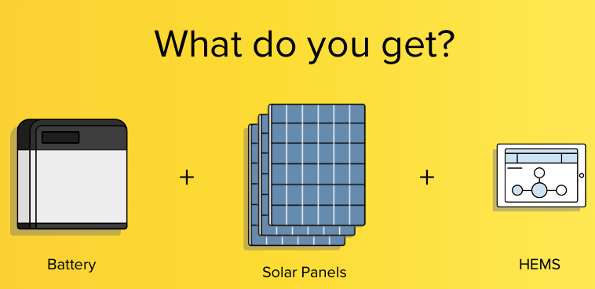
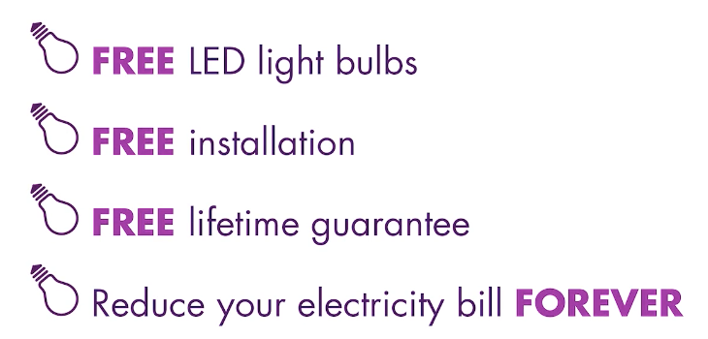
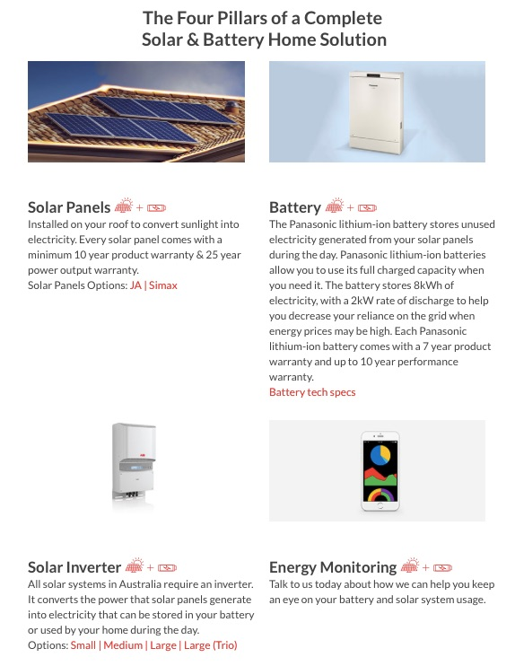
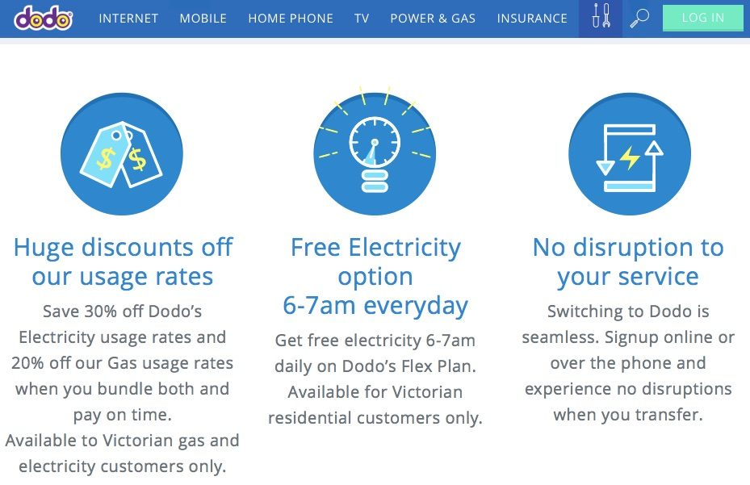
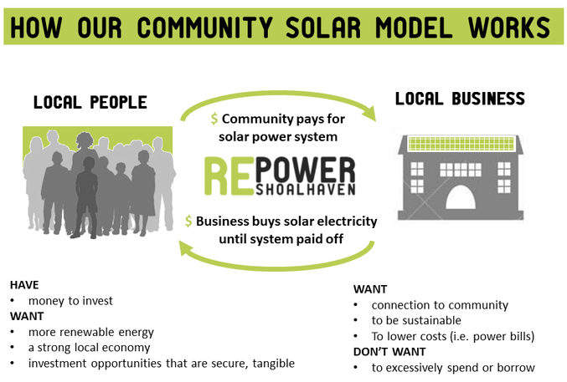
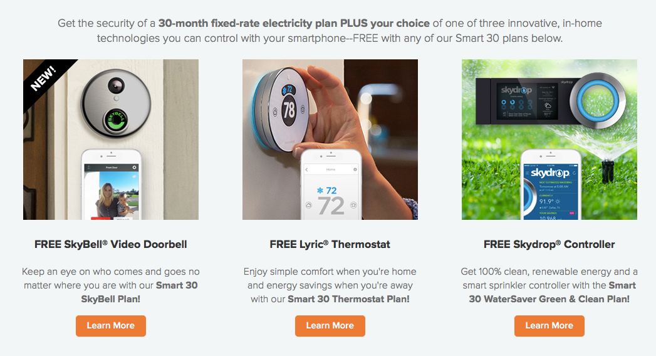
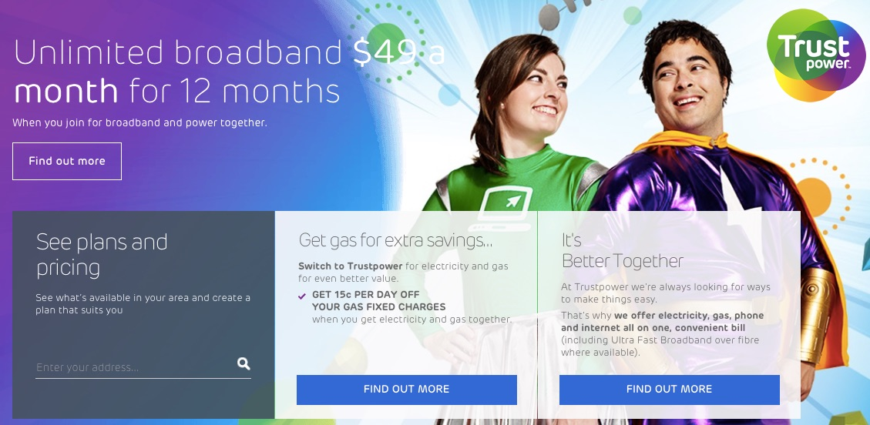
Future Energy Bundling Elements
Storage
Solar
Heating
Lighting
Electricity
Gas
Installation
Maintenance
Insight – Advice
Home-Security
Entertainment
HEMS
Energy Savings
EV
EV charging
Home Automation
Telecoms
Micro-Grids
Community Energy
Insurance
Good Causes
…

