Slide 1
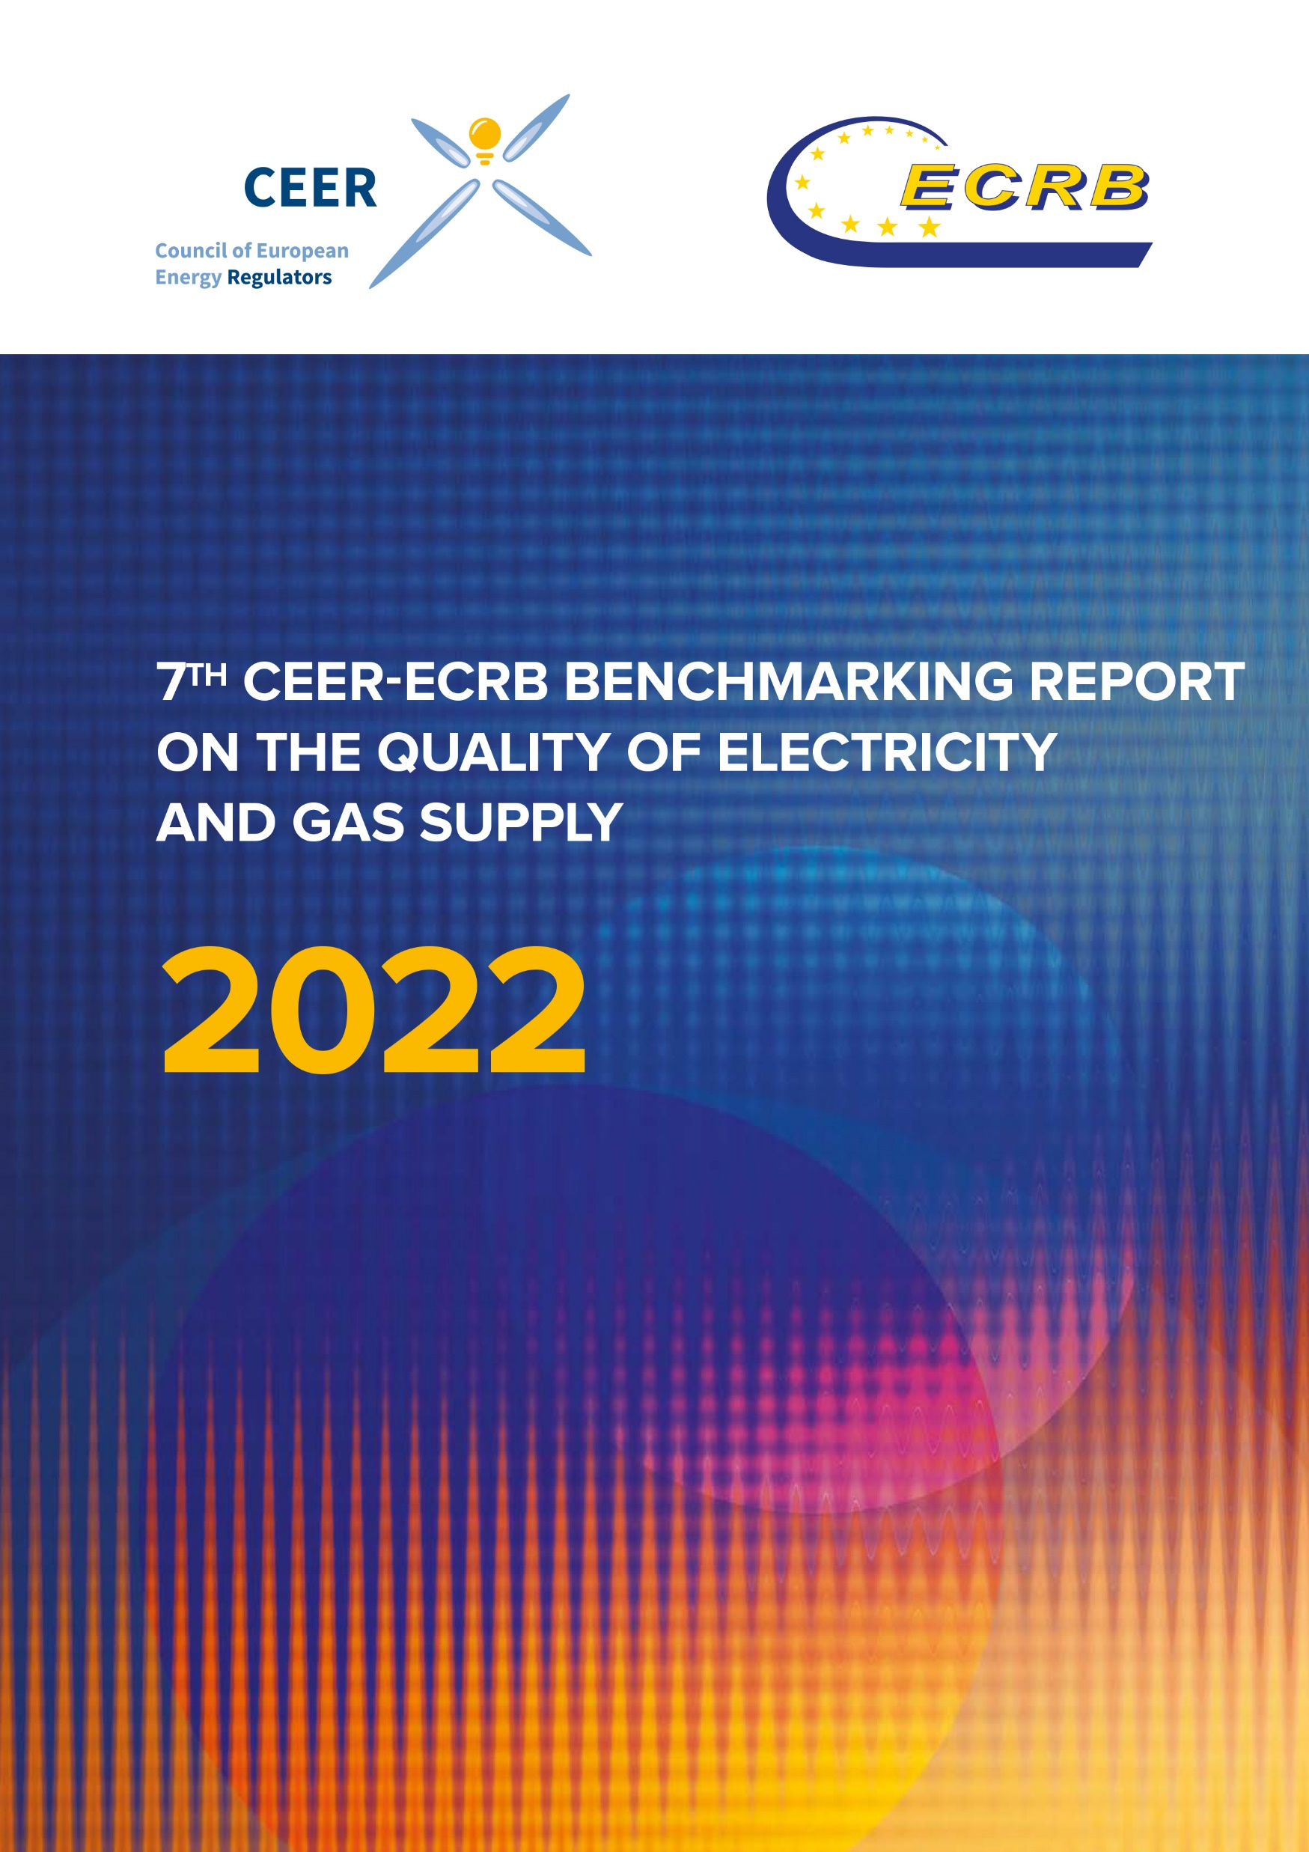
CEER-ECRB
Webinar on the 7th Benchmarking Report on the Quality of Electricity and Gas Supply
2 February 2023
10:30-11:45 CET

Slide 2
CEER-ECRB Webinar on the 7th Benchmarking Report on the Quality of Electricity and Gas Supply

Slide 3
CEER-ECRB Webinar on the 7th Benchmarking Report on the Quality of Electricity and Gas Supply
Welcome Remarks
Marko Bislimoski (ERC)
ECRB President

Slide 4
CEER-ECRB Webinar on the 7th Benchmarking Report on the Quality of Electricity and Gas Supply
Introductory Remarks
Frédéric Marijsse (ILR)
Vice Chair of the CEER Distribution Systems Working Group

Slide 5
CEER-ECRB Webinar on the 7th Benchmarking Report on the Quality of Electricity and Gas Supply
Presentation of the 7th Benchmarking Report on Quality of Electricity and Gas Supply
Ognjen Radović (E-Control)
Co-Chair of the CEER Energy Quality of Supply Workstream

Slide 6
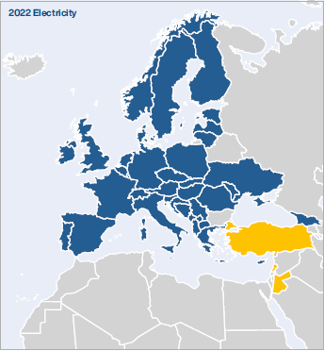
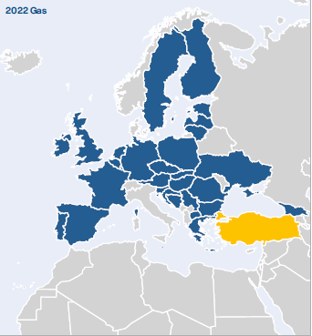
Background (1)
Since 2001, the Council of European Energy Regulators (CEER) has routinely surveyed, analysed and reported on the quality of electricity and (since 2016) gas supply in European countries, the results of which are presented in its Benchmarking Reports
Since then, the Benchmarking Report has gained importance and acknowledgement across Europe
The number of participating countries increased from 6 in the 1st edition to 39 in the 7th edition of the Benchmarking Report

Slide 7
Background (2)
For the first time, the report was co-written by the CEER and Energy Community Regulatory Board (ECRB) experts: specifically, the CEER Energy Quality of Supply Work Stream (EQS WS) and the ECRB Customers and Retail Markets Working Group (CRM WG)
As a major improvement and with the aim of providing an extended and more reliable database and expanding the number of participants, the Energy Community Contracting Parties are included in the main body of the report (instead of in an annex as before)

Slide 8
History of the Report (1)
1st CEER Benchmarking Report – 2001
2nd CEER Benchmarking Report – 2003
3rd CEER Benchmarking Report – 2005
4th CEER Benchmarking Report – 2008
5th CEER Benchmarking Report – 2011
  CEER Benchmarking Report 5.1 – 2014 (Continuity of Supply)
  CEER Benchmarking Report 5.2 – 2015 (Continuity of Supply)
6th CEER Benchmarking Report – 2016
  CEER Benchmarking Report 6.1 – 2018 (Continuity of Supply in Electricity and Gas)

Slide 9
History of the Report (2)
The questionnaire for the 7th Benchmarking Report was prepared and sent out in 2019
Drafting started in 2020 with multiple delays due to low resources and the lack of physical meetings during the pandemic
It was published in December 2022

Slide 10
Structure of the Report
Introduction
Electricity – Continuity of Supply
Electricity – Voltage Quality
Electricity – Commercial Quality
Gas – Technical Operational Quality
Gas – Natural Gas Quality
Gas – Commercial Quality

Slide 11
Contents
As before, this Benchmarking Report addresses three major aspects of the quality of supply
Electricity | Gas
Continuity of Supply | Technical Operational Quality
Availability of electricity and incentives used to improve it Technical characteristics of grids | Availability of gas and technical characteristics of the grid
Voltage Quality | Natural Gas Quality
Technical properties of supplied electricity | Chemical composition
Commercial Quality
The speed and accuracy with which customer requests are handled

Slide 12
Continuity of Supply
Electricity

Slide 13
Electricity Continuity of Supply
Continuity of supply (CoS) concerns interruptions in electricity supply
Continuity of supply is usually described with indicators depicting the number of interruptions, unavailability (duration) and energy not supplied per year
Data collected for the period 2010-2018
The chapter is based on input from 38 countries

Slide 14
Interruptions
Interruptions can be divided into:
  Planned and unplanned
    Planned interruptions are those of which network users are informed in advance (the requirement in Europe varies between 24h and 30 days)
  Long and short (and transient)
    Common definition: long interruption > 3 min, 1 sec < short < 3 min, transient < 1 sec
  Those that include exceptional events and those that exclude them
    Every country has a different definition but causes can be natural (strong winds, snowstorms, floods, earthquakes…) and non-natural (wars, sabotage, embargos…)

Slide 15
CoS Indicators
A wide range of indicators is implemented across the EU
The two most common indicators:
  SAIDI (system average interruption duration index) – average amount of time per year that the supply to a customer is interrupted (minutes per customer per year)
  SAIFI (system average interruption frequency index) – average number of times per year that the supply to a customer is interrupted (interruptions per customer per year)
Examples of other indicators:
  AIT (average interruption time) – the amount of time that the supply is interrupted (minutes per year)
  ENS (energy not supplied) – total amount of energy that would have been supplied to customers had there been no interruption

Slide 16
Main CoS findings (1)
Electricity CoS is monitored in all responding countries, but vast differences exist in the type of interruptions monitored, indicators used, their calculation and the voltage levels included in them
Interruptions originating on high and medium voltage are monitored in all countries where those voltage levels are defined, but there are significant differences in definitions of voltage levels across Europe
Unplanned interruptions are monitored in every responding country (regardless of whether legal obligations for monitoring exist) while planned interruptions are not
The monitoring usually covers long interruptions whereas less than half of respondents collect data on short or transient interruptions

Slide 17
Main CoS findings (2)
Excluding exceptional events, the majority of countries decreased or at least maintained their unplanned minutes lost and the number of interruptions per customer from the beginning to the end of the observed period (2010 to 2018). There are, however, exceptions to this observation
Large variations exist among the respondents:
  Unplanned SAIDI (excluding exceptional events) ranges from 9 to 4,982 minutes per customer
  Unplanned SAIFI (excluding exceptional events) ranges from 0.20 to 55.31 interruptions per customer
  Planned SAIDI ranges from 0.23 to 5,144 minutes per customer
  Planned SAIFI ranges from 0.00 to 45.47 interruptions per customer

Slide 18
Incentive regimes
The chapter on CoS also explores regulatory incentive regimes implemented at system and individual user level
Overall (system level) incentive-based schemes are in place in 19 responding countries. The majority are applied in distribution but there are also incentive schemes in transmission. Most countries use a combination of rewards and penalties, while very few respondents have regimes that focus exclusively on penalties. No country reported using only rewards in their continuity of supply incentive schemes
Individual compensation to customers is in place in two thirds of responding countries. In most cases, financial compensation is awarded if a single interruption or the total duration of yearly interruptions exceeds certain duration or if the yearly number of interruptions exceeds a certain limit. Compensation can be automatic or on customer request. Automatic compensation is offered in 14 countries

Slide 19
CoS recommendations
It is recommended to include all incidents at all voltage levels in interruption statistics
Harmonise the methodology to calculate CoS indicators. Common weighting methods and rules for aggregation of subsequent short interruptions should be introduced
Establish the definition of exceptional events in each country
Harmonise them at the European level in the interest of achieving comparable indicators
Apply adequate incentive schemes, if economically viable, in both distribution and transmission
Implement compensation payments (for each voltage and/or capacity level) for network users affected by very long interruptions

Slide 20
Voltage Quality
Electricity

Slide 21
Voltage Quality (1)
Voltage Quality (VQ) is the most technically complex part of the quality of electricity supply. It covers deviations from optimum values in voltage magnitude or waveform
In this Benchmarking Report, VQ refers to all disturbances in the supply of electricity except interruptions
Examples of voltage quality disturbances: supply voltage variations (due to large load changes), voltage dips (due to short-circuits in the grid), voltage swells, flicker, harmonic voltage…

Slide 22
Voltage Quality (2)
Everyone connected to the power grid could influence the quality of the voltage
Voltage disturbances are becoming an increasingly important issue due to the increasing susceptibility of end-user equipment and industrial installations
It is expected that the need for proper regulation of voltage quality will increase with distributed generation. Regulating VQ includes setting standards and minimum requirements, implementing rewards/penalties, publishing and setting obligations
CEER began addressing voltage quality in 2005 (3rd Benchmarking Report)
The chapter is based on input from 34 countries

Slide 23
EN 50160
European Standard EN 50160 gives an overview of all voltage quality disturbances and sets limits for many of them
All respondents apply the EN 50160 standard for voltage quality, or their requirements for VQ are based on this European standard. This ensures a harmonised understanding of VQ phenomena throughout Europe
There are countries, however, where additional requirements have been implemented, mainly to enforce stricter limits

Slide 24
Main VQ findings
Voltage quality is monitored in grids (either transmission or distribution but in most cases both) of 24 responding countries, but indicators that are monitored differ between them
‘Supply voltage variations’ is the most monitored VQ indicator. The majority of respondents indicated that their system operators are obliged to measure voltage quality on request from end-users. In a few countries, the end-user must pay for this service
Most countries indicated that they have requirements for smart meters and that the meters allow the monitoring of voltage quality, but the penetration rates vary between close to no smart meters installed and a near completion of the full roll-out
In some countries, end-users are subject to compensation or a lower tariff if the standard for voltage quality is not met

Slide 25
VQ recommendations
It is recommended to inform the end-users of the VQ, either on their request or by publishing the VQ monitoring data
Education and awareness on how VQ issues might affect the network and consumers will contribute to reducing inconveniences due to voltage disturbances
With distributed generation and smart meter penetration growing at a fast pace, it is recommended to perform more investigations into the use of smart meters for VQ monitoring
Further investigate how VQ is influenced by distributed generation and prosumers

Slide 26
Commercial Quality
Electricity

Slide 27
Electricity Commercial Quality
Commercial Quality (CQ) is directly associated with transactions between electricity companies and customers. In other words, it is the speed and accuracy with which customer requests are handled
Commercial transactions between electricity companies and their customers are traditionally classified as follows:
  Pre-contract transactions, such as information on connection to the network
  Transactions during the contract period, such as billing, payment arrangements and responses to customer complaints
The chapter is based on input from 34 countries

Slide 28
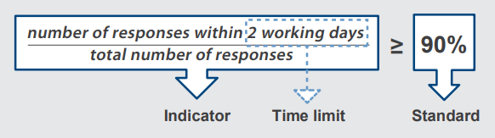
CQ Indicators Vs Standards
Distinction between Indicators and Standards
Indicators define a way to measure dimensions of service quality
Standards refer to the minimum level of quality, as defined by NRAs
NRAs can define Standards for Indicators or define Indicators without Standards

Slide 29
Types of CQ Indicators
There are 3 different types of CQ Indicators:
  Guaranteed indicators (GI) refer to quality levels that must be met in each individual case. If not, a customer must be compensated
  Overall indicators (OI) refer to a given set of cases and must be met with respect to the whole population in that set (often used for minimum level of performance such as: 90% of new customers have to be connected to the grid within 2 weeks). A penalty is paid in case of non-compliance
  Other requirements (OR) are additional requirements issued by NRAs to achieve a certain level of quality. If not met, NRAs could impose sanctions

Slide 30
Electricity CQ Indicator groups
To simplify the approach to such a complex matter as CQ, indicators relating to electricity CQ have been traditionally classified into four main groups:
  Group I: Connection (e.g. time duration of connecting customers to grid)
  Group II: Customer care (e.g. time to respond to customer inquiry/complaint)
  Group III: Technical service (e.g. resolution of VQ problems)
  Group IV: Metering and billing (e.g. time from the notice to pay until disconnection)

Slide 31
Main electricity CQ findings
There is an increased focus on the quality of services provided to customers. According to analysis for this report, 21 different indicators are used in electricity, with network connection and time to respond to customer complaints being the most important. Most commercial quality obligations focus on DSOs
Progresses in harmonisation have been achieved compared to previous CEER Benchmarking Reports
There is a general trend over time to move toward Guaranteed Indicators (GIs) for which customers must receive compensation (subject to certain exemptions) if the required service level is not provided. Compensations can be paid automatically or on customer request
In some countries, a maximum yearly amount that a customer can receive for non-compliance with GI has been introduced. Automatic compensation is being increasingly applied
Commercial quality in electricity is mainly focused on residential customers connected to low voltage (LV) network because they represent the largest group and because small domestic customers often need more protection

Slide 32
Electricity CQ recommendations
Ensure greater protection through GIs with automatic compensation for customers
For the most important indicators (e.g. for connection activities), a combination of OIs with economic sanctions (like penalties) and GIs is recommended
Automatic compensation, which is increasingly applied, should be extended to every country
Most indicators consider only written forms of communication (letters), which provides an incomplete picture of the CQ. Other forms of communication such as telephone and email should also be considered

Slide 33
CEER-ECRB Webinar on the 7th Benchmarking Report on the Quality of Electricity and Gas Supply
Presentation of the 7th Benchmarking Report on Quality of Electricity and Gas Supply
Michael Westermann (BNetzA)
Co-Chair of the CEER Energy Quality of Supply Workstream

Slide 34
Technical Operational Quality
Gas

Slide 35
Structure of this chapter
Brief overview on the structure of gas networks and CoS indicators used and regulation that is applied in CEER and ECRB countries
  Overview of the structure of the gas networks
  CoS indicators provided by these countries are presented
  Overview of the regulation in force dealing with CoS and safety
Input from 30 participating countries
  The availability of data and information differs across questions, which recommends a cautious interpretation of comparison

Slide 36
General Remarks (1)
In general, quality of supply regulation of gas networks does not differ from that used in electricity
  SAIDI, ASIDI, SAIFI, and CAIDI are in use reporting countries
  Some countries use indicators for both frequency and duration and some distinguish between planned and unplanned interruptions
  Continuity of Supply in general is high, due to the ability of gas to be stored
But the underlying objective is entirely different

Slide 37
General Remarks (2)
Since gas is a natural resource its quality and composition is of particular importance
Moreover, technical safety is of much higher importance than in the electricity since an interruption of gas delivery may give rise to physical danger and in the worst case fatalities
  Interruptions in gas are much less common than those in electricity due to greater efforts to avoid them.
  Even though they are less frequent, interruptions of gas supply usually last longer than those in electricity.
An extensive set of gas technical standards and rules have been established for gas internationally

Slide 38
Main Gas TOQ Findings (1)
Indicators used for CoS and technical safety vary distinctly across Europe
  Although there is general availability of information on CoS indicators, the level of detail shows huge differences
  Technical safety plays a very important role in the gas sector with indicators, such as leaks, used to describe the technical quality of the infrastructure
  The effect of leaks on CoS can differ, since not every leak inevitably entails an interruption for the customer

Slide 39
Main Gas TOQ Findings (2)
Odorisation improves safety and is required in most European countries
  Odorisation is part of risk management and is required to detect the presence of gas before it can reach combustible levels and cause fires or explosions
  In 28 countries, DSOs have some obligations regarding gas odorisation

Slide 40
Main Gas TOQ Findings (3)
Gas storage infrastructure – when used – is regulated in only about half of the countries
  Gas storage facilities are used in 19 countries and regulated in ten
  Regulation may apply to the maximum storage, injection/ withdrawal capacity, to tariffs or the minimal quantity of gas to be stored
LNG infrastructure is used in 12 responding countries and regulated in ten

Slide 41
Main Gas TOQ Recommendations (1)
Expand the coverage of monitoring of CoS and safety indicators and promote further harmonization of these indicators
  An extension of the reported indicators makes a comparison across countries easier
  The definition of a basic set of indicators might be useful
  Since the definitions of indicators in use differ widely among countries, a move towards harmonisation of parameters such as weighting methods would make comparability of values more reliable

Slide 42
Main Gas TOQ Recommendations (2)
Further develop the LNG infrastructure
  LNG, which can be imported by sea, offers an alternative to common gas supply by pipelines
  More topical than ever, LNG plays an important role in the EU energy policy, which aims at providing its consumers with safe, balanced and competitive energy at affordable prices

Slide 43
Natural Gas Quality
Gas

Slide 44
Structure of this chapter
Summary of technical parameters and overview of definitions and applications in the reporting countries
  This chapter only describes the application of the parameters and no other topics, such as responsibilities of the involved parties
This chapter is based on answers provided by 28 countries
In Austria and Germany, parameters are not monitored by NRAs but defined by technical associations (OVGW and DVGW) which set binding guidelines and technical rules

Slide 45
General Remarks/ Main Findings (1)
Some natural gas parameters represent the chemical composition of natural gas (methane, sulphur, carbon dioxide, etc.)
Other parameters such as Wobbe Index, relative density or water/hydrocarbon dew point are considered important quality parameters and are sometimes stipulated in contractual specifications and enforced throughout the natural gas supply chain, all the way to end users

Slide 46
General Remarks/ Main Findings (2)
A majority of countries monitor gross calorific value (24 countries), water/hydro dew point (22 countries) and Wobbe index (22 countries)
  Wobbe index as a main indicator of the interchangeability of fuel gases is used to compare the combustion energy output with different composition of fuel gases
Many countries already rely on CEN standard EN16726, though not being legally binding
  This might contribute to reducing restrictions in cross-border gas flows and increasing the commercial market efficiency

Slide 47
Commercial Quality
Gas

Slide 48
General Remarks (1)
Gas CQ was first evaluated in the 6th BR
Commercial Quality (CQ) covers the speed and accuracy with which customer requests are handled
The structure of the questionnaire and the chapter in the report are similar to that in the electricity chapter, that means
  A distinction is made between Indicators and Standards
  There are three different types of indicators used
The chapter is based on input from 29 countries

Slide 49
General Remarks (2)
Indicators related to gas CQ are traditionally classified into five main groups:
  Group I: Customer care (e.g. time to respond to customer inquiries or complaints)
  Group II: Grid access (e.g. duration of connecting customers to grid)
  Group III: Activation, deactivation, and reactivation of supply
  Group IV: Metering (e.g. time for meter verification)
  Group V: Invoices (e.g. time to switch supplier on customers request)

Slide 50
Main Gas CQ Findings (1)
A broad but increasingly harmonised range of CQ indicators is monitored
  There are significant differences concerning the nature and the number of indicators monitored across countries
  NRAs set the CQ regulations, taking into account their national, political, cultural and economic specificities
  It is worth noting that NRAs apply identical or similar regulations concerning CQ indicators

Slide 51
Main Gas CQ Findings (2)
CQ requirements vary greatly depending on the customer type or on the company involved
  CQ requirements in different countries depend significantly on the customer type, the pressure level and location
  Furthermore, many countries set different requirements (time limits, set of indicators) depending on the type of company involved (TSO, DSO, supplier)

Slide 52
Main Gas CQ Findings (3)
There is an increased focus by NRAs on the quality of the services provided to customers
  Similar to past Benchmarking Reports, it can be seen, that the NRAs devote significant attention to the CQ of the services provided
CQ is mainly focused on the DSO’s relationship with customers
  The reporting countries are focused more on the DSOs’ CQ obligations rather than those of the suppliers’ as the distribution activities are closely linked to customers

Slide 53
Main Gas CQ Findings (4)
There is a general trend towards the use of Guaranteed Indicators (GIs) for which customers must receive compensation
Regulation of these GIs shows clear variations
  Compensations are paid automatically or on customer request
  The amount of compensation can be set in various ways
    as a fixed value or as a fixed value per day (period),
    depending on the customer’s bill or on the payment for a service,
    as amount being subtracted from the bill or as a direct payment to the customer
  Some countries have introduced a maximum yearly amount that a customer can receive for non-compliance

Slide 54
Main Gas CQ Recommendations (1)
Perform regular reviews of national regulations
  It is important to regularly review the CQ indicators, taking into account the development of national conditions and the expectations of customers
  The most important factor in this process is the availability of wide and reliable data
  Therefore, it should be examined if additional indicators or requirements should be monitored

Slide 55
Main Gas CQ Recommendations (2)
Pursue a further harmonisation of CQ indicator definitions
  Harmonising the definitions would facilitate a more consistent and understandable database
  Comparisons are sometimes difficult to make as the regulation of a given activity can be achieved in many ways, depending on the country
  A clear framework and harmonised parameters, definitions and principles of indicator measurement can help the analysis of the results and thus the identification of further possible improvements and recommendations

Slide 56
Main Gas CQ Recommendations (3)
NRAs should monitor indicators in all forms of communication for more accurate performance levels
  It is recommended for NRAs, to regulate the performance of the service level provided to customers through every form of communication, such as phone, e-mail and online, and through visits to customer centres
  The increasingly important field of phone contacts should be monitored, especially in the performances of DSOs and suppliers
  Attention should be paid not only to the speed but also to thoroughness and usefulness of a response

Slide 57
CEER-ECRB Webinar on the 7th Benchmarking Report on the Quality of Electricity and Gas Supply
Clarificatory Q&A

Slide 58
CEER-ECRB Webinar on the 7th Benchmarking Report on the Quality of Electricity and Gas Supply
Closing remarks
Edin Zametica (SERC)
Chair of the ECRB Customers and Retail Markets Working Group

Slide 59


Thank you for your attention!
www.ceer.eu
www.energy-community.org

