Slide 1
ACER Gas Wholesale Market Monitoring Report 2021
Key findings and Recommendations
Online webinar, 8th July 2022

Slide 2
Welcome

Slide 3
To enable everyone to contribute To ensure a productive workshop
Meeting will be recorded
Participants are muted, except speakers
When you have a question, please:
Post your question in the chat
Include your name and affiliation in the question
Questions will be answered in the Q&A session

Slide 4
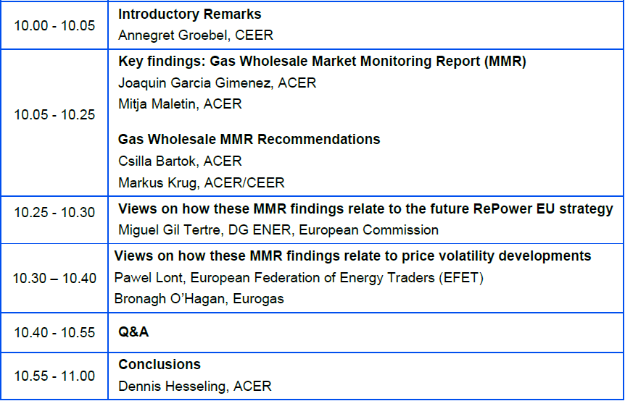
Agenda
Market Monitoring web portal link

Slide 5
Key findings of the Report

Slide 6
Three phases, each with different dynamics
Overview of events and market fundamentals driving EU gas prices - TTF month-ahead contract (euros/MWh) - May 2021 - June 2022
Russian invasion of Ukraine
(End of February 2022)
Sizeable increase in EU LNG supply
(End of December 2021)
Higher than expected Russian flows; reassessment of supply diversification options
(Mid-March – May 2022)
Uncertainty on Russian supply: Nord Stream 2 appeals BNetzA’s ruling, exports across Yamal cease, low injections into Gazprom-held storage
(Fall 2021)
Tight LNG supply; narrow pipeline flows
(Summer 2021)
Gazprom halts supplies to various Member States, followed by reduced flows via Nord Stream 1
(June 2022)
High LNG imports do not fully offset the effects on prices of limited Russian flows and low storage stocks
(December 2021 – February 2022)
The gas price surge can be split into three distinct phases. In the latest phase, price developments are since recently affected by supply scarcity risks
Source: ACER based on ICIS Heren’s price data

Slide 7
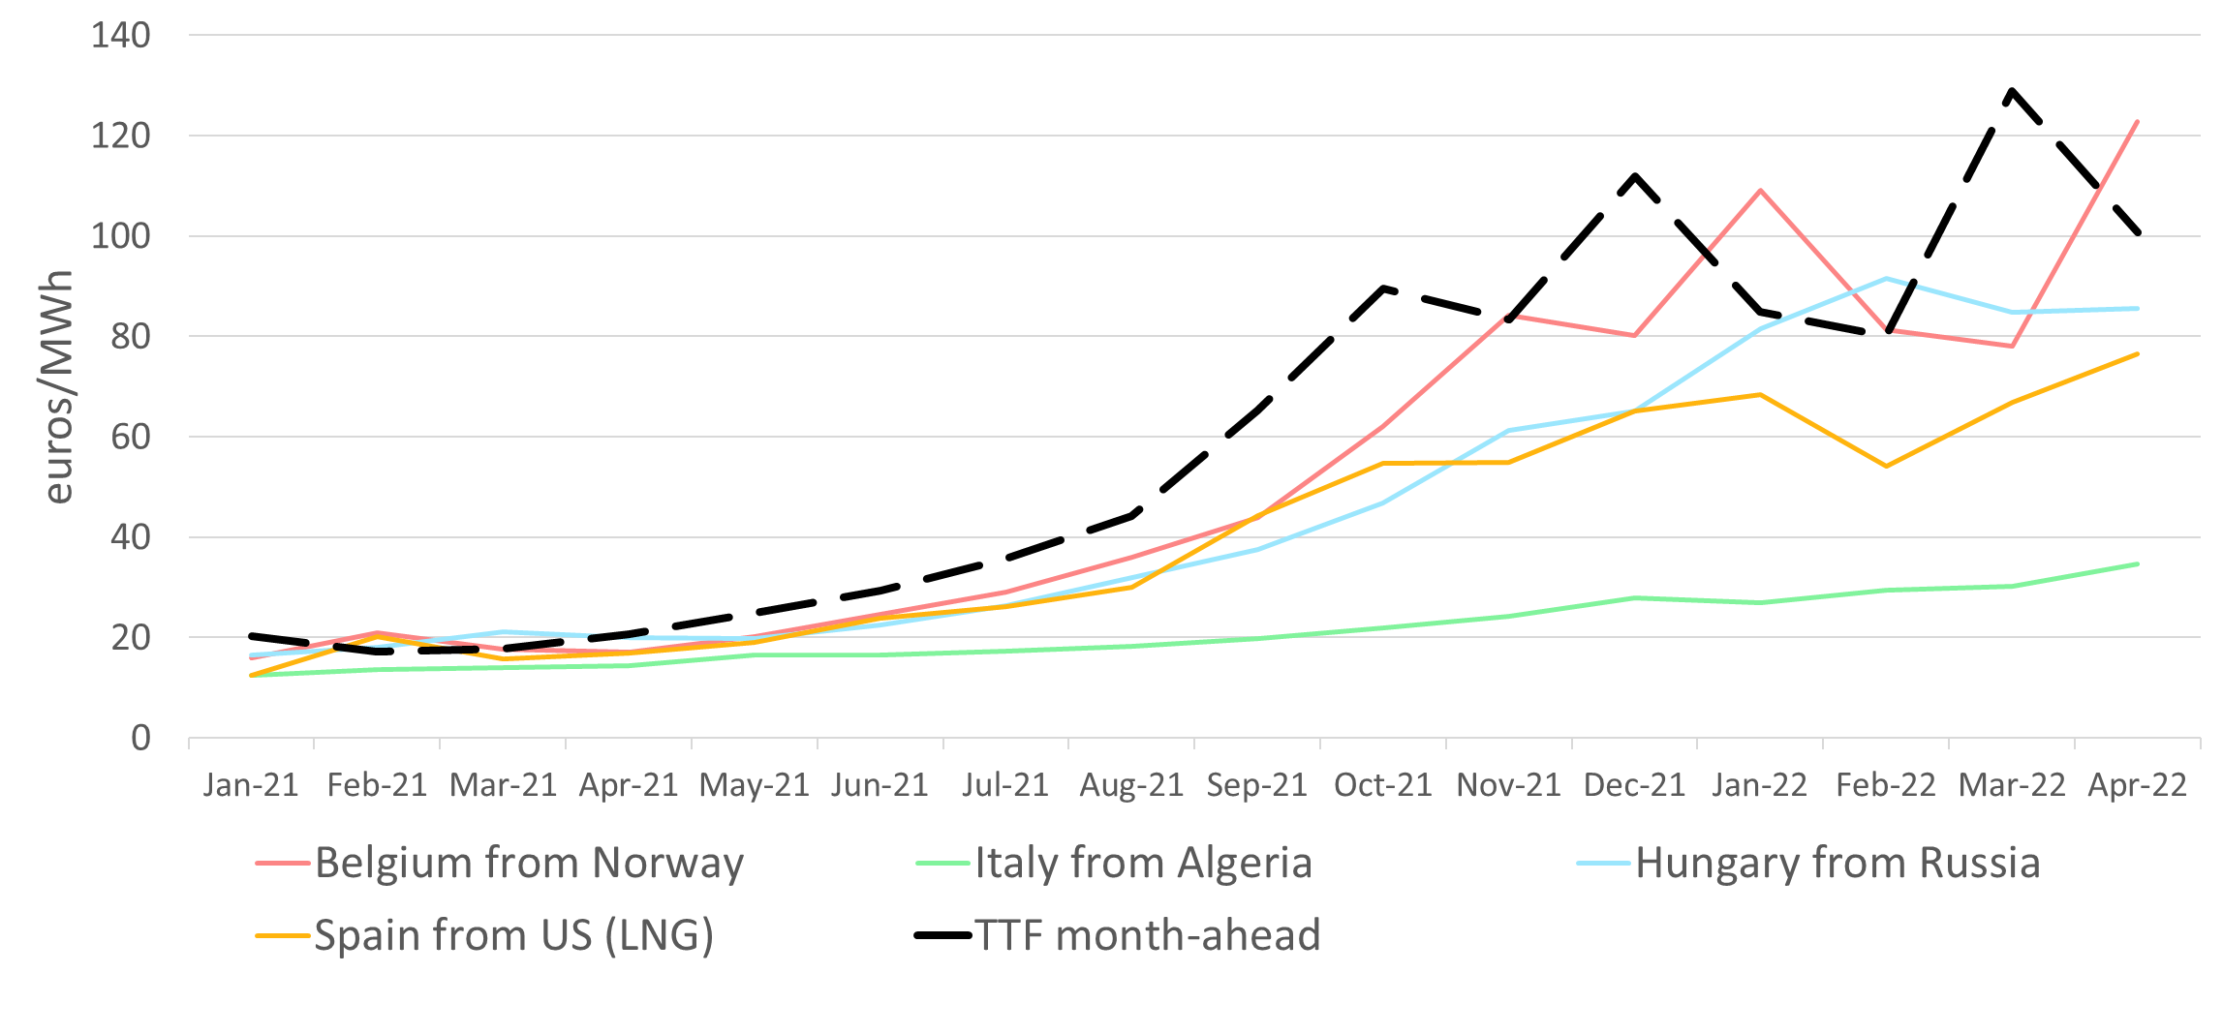
Selected long-term contracts are significantly cheaper than hub-priced gas supply
Estimated prices of long-term supply contracts at selected MS from selected supply origins - euros/MWh - 2021 – April 2022
Hub products / spot
Long-term contracts’ price formulas
Oil-products / time lagged
Long-term supply contracts’ prices show a considerable variation depending on the employed price formulas
Source: ACER calculation based on ICIS Heren and Eurostat Comext

Slide 8
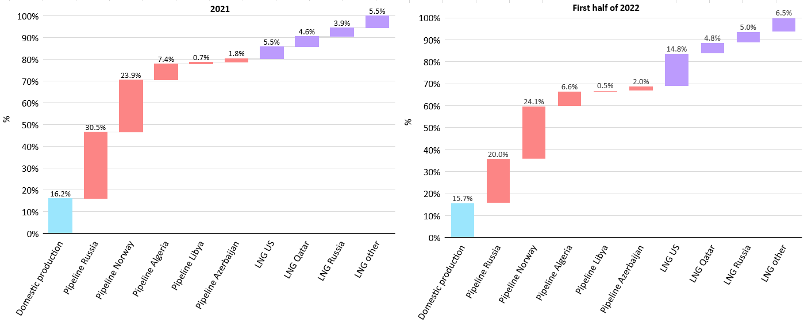
Lower Russian supply balanced so far by increased LNG supply and lower consumption
EU and UK gas supply portfolio by origin – 2021 (100% = 480 bcm) vs First Half 2022
+ 28 bcm YTD
- 29 bcm YTD
While LNG supply is rising significantly (+60% YTD), mostly coming from the US, it will be a challenge to meet the targeted two thirds reduction of Russian supply (-40% YTD)
Source: ACER calculation based on International Energy Agency, Refinitiv, Gassco,, ENTSOG and Eurostat

Slide 9
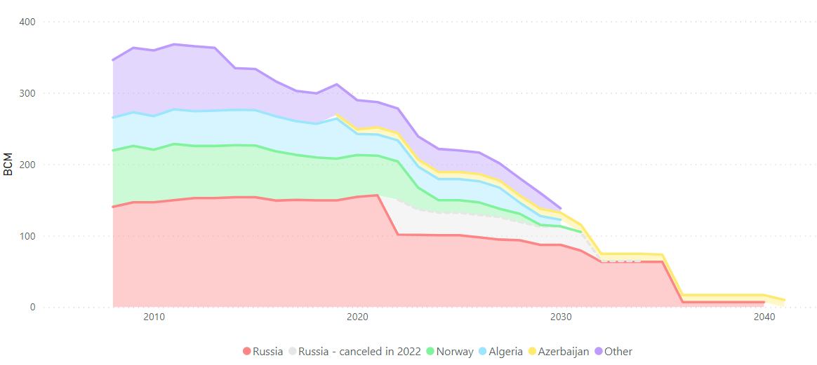
Russian long-term contracts cancelled in 2022 account for a modest share of prevailing supply commitments
Evolution of the nominal capacity of pipeline long-term supply contracts prevailing in the EU and expiration calendar – bcm/year
EU intends to end reliance on Russian gas in 2027
Russian long-term contracts towards EU markets last significantly beyond 2027. This adds complexity to current considerations.
Source: ACER calculation based on Cedigaz and National Regulatory Authorities

Slide 10
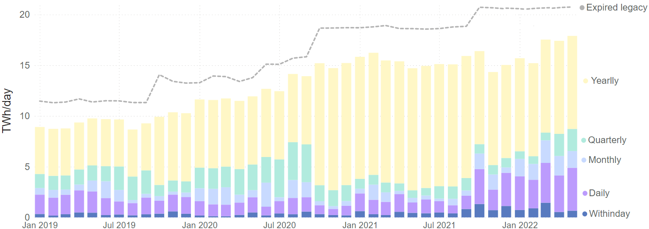
IP bookings flexibly reacting to shifting flow patterns, although network bottlenecks and auction issues emerged
Gas capacity booking trends - breakdown of CAM booked transportation capacity and expired legacy booked capacity – MWh/day yearly average – 2019 – May 2022
From Q4 2021 rising short-term bookings are observed in view of the EU gas system reconfiguration: i.e. rising LNG, West-to-East rising flows
Source: ACER estimate based on ENTSOG, PRISMA, RBP and GSA

Slide 11
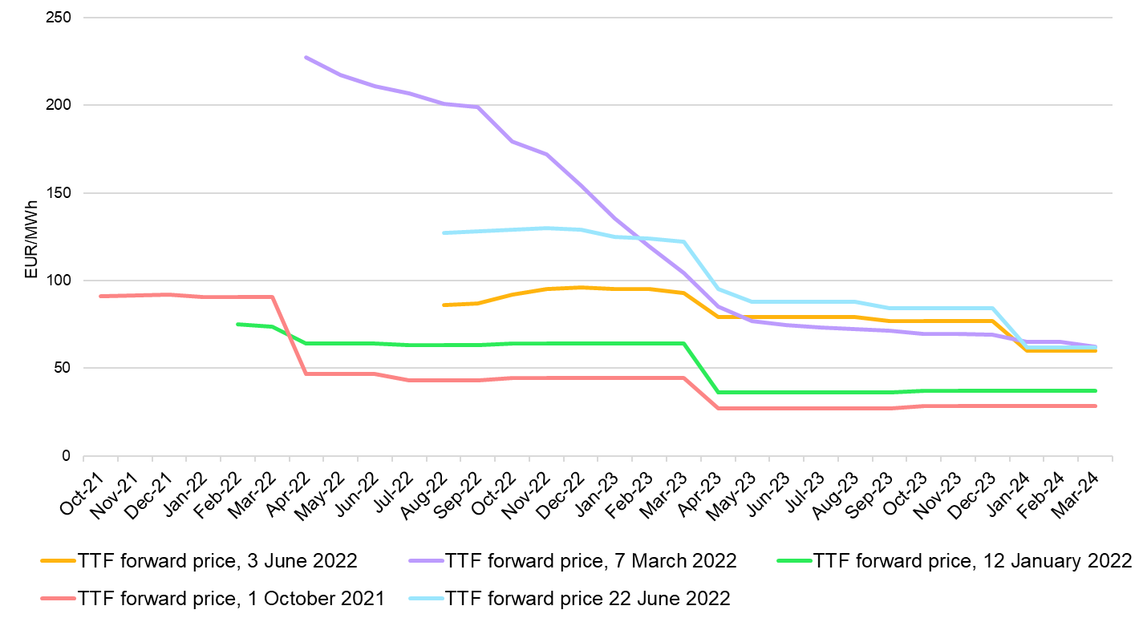
Market expectations point to current high prices persisting until 2024
Evolution of gas (TTF) forward prices comparing the contractual outlook (October 2021 - June 2022)
Gazprom halts 60% of supply across Nord Stream
Mid-June 2022
.
Forward gas prices have risen recently due to reduced gas deliveries, in particular via Nord Stream 1
Source: ACER calculation based on ICIS Heren

Slide 12
Recommendations

Slide 13
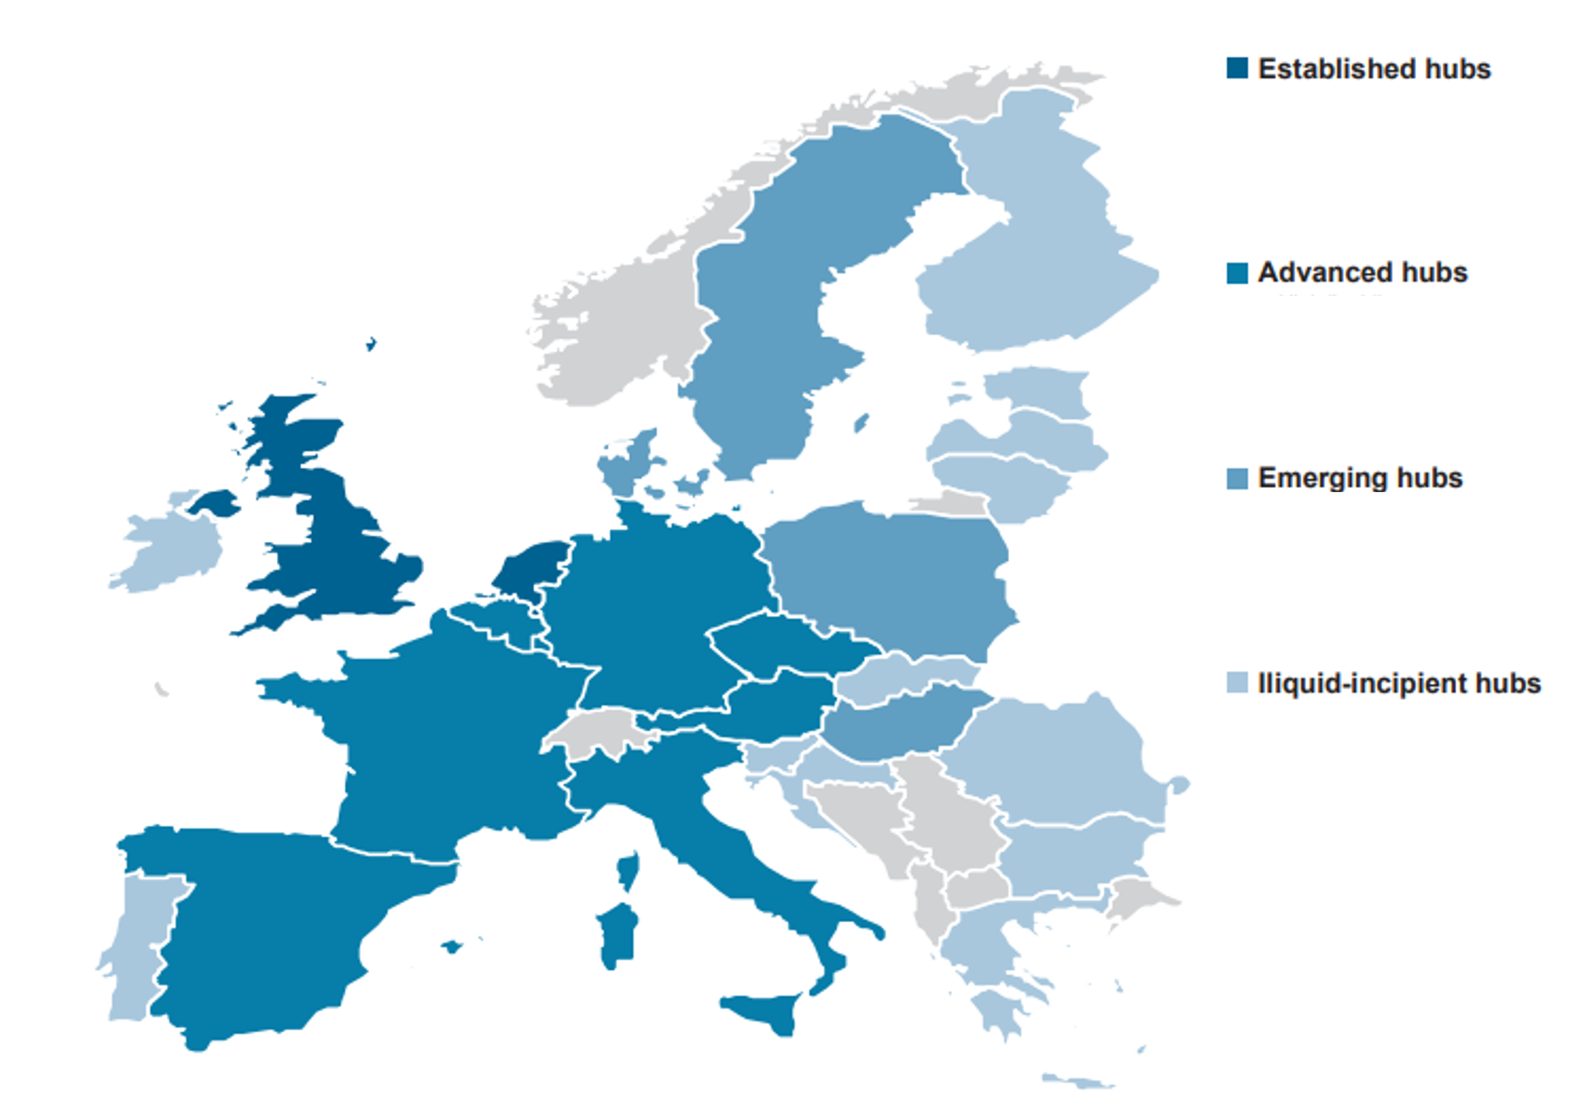
Area I: Gas contracting equilibrium
What to preserve?
What to accelerate?
What to change?
Hub prices and hub trading have managed to attract additional supplies into the EU as well as sustained market integration
Re-establishing security of supply is key. That might entail signing new long-term supply contracts. Companies shall aim for as much supply flexibility as possible, in view of the reducing role of gas
Explore the use of the EU energy purchase platform to enhance the EU buyers’ negotiation power and to avoid outbidding each other
Consider implementing oversight measures over interval price limits at gas trading hubs
Implement centralised and mandatory reporting of long-term contracts in the EU

Slide 14
Area II: Preparation for the next winter: Enhance infrastructure flexibility, demand savings and monitoring
What to preserve?
What to accelerate?
What to change?
The current low barriers to cross-border trade, also facilitated by harmonised network codes
The improved cross-border transportation capacities, including reverse flows, that are enabling diversifying gas supply away from Russia
Speed up targeted ‘LNG and congestion’ related investments. Do that under a regionally coordinated approach, to optimise resources. Allow new infrastructure to flow hydrogen
Implement demand saving strategies in a coordinated manner and based on CBAs
Further promote demand-side response. Implement competitive processes that compensate consumers offering to limit consumption
Ensure that storage regulation is resilient against external supply shocks. ACER backs the EC and Member States ongoing initiatives addressing these issues: e.g. filling targets

Slide 15
Views on MMR findings

Slide 16
Markets continue to work and support supply security
Strong preference for long-term contracts may have its consequence
Storage filling obligations can help ensuring a tool for direct crisis response, but do not offer more gas under the current shortage
Many barriers to trade still exist throughout Europe and need to be addressed.

Slide 17
Q&A

Slide 18
Back-up

Slide 19
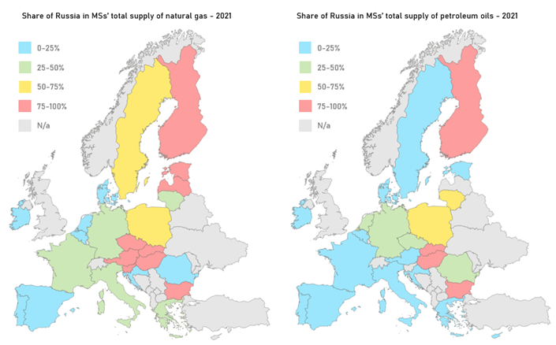
Energy dependence on Russia is significant although gradually declining
Share of Russian physical gas and oil in total supply of individual MSs – 2021 - % ranges
Source: ACER based on Eurostat data.

Slide 20
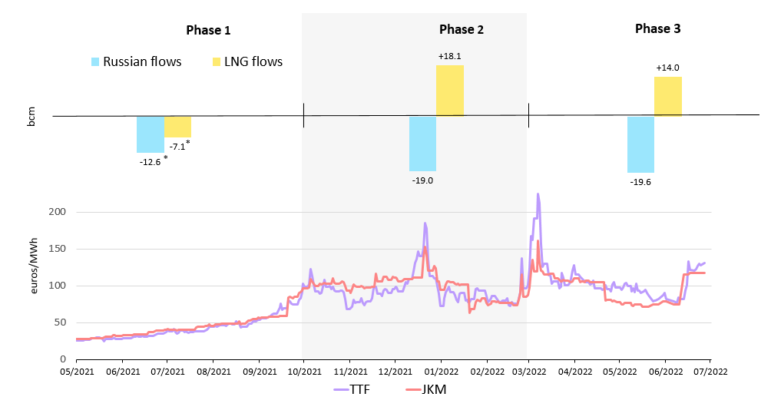
Increasing LNG deliveries are addressing the reduction in Russian supply
Comparison of European and Asian wholesale price spreads vs EU+UK LNG and Russian pipeline imports – 2021 to July 2022 – euros/MWh and bcm/period
The price spreads between Europe and Asian gas markets, along with the need to replace Russian flows, have highly determined the volumes of LNG shoring into the EU across last months
Source: ACER calculation based on ENTSOG, Refinitv and ICIS Heren data.

Slide 21
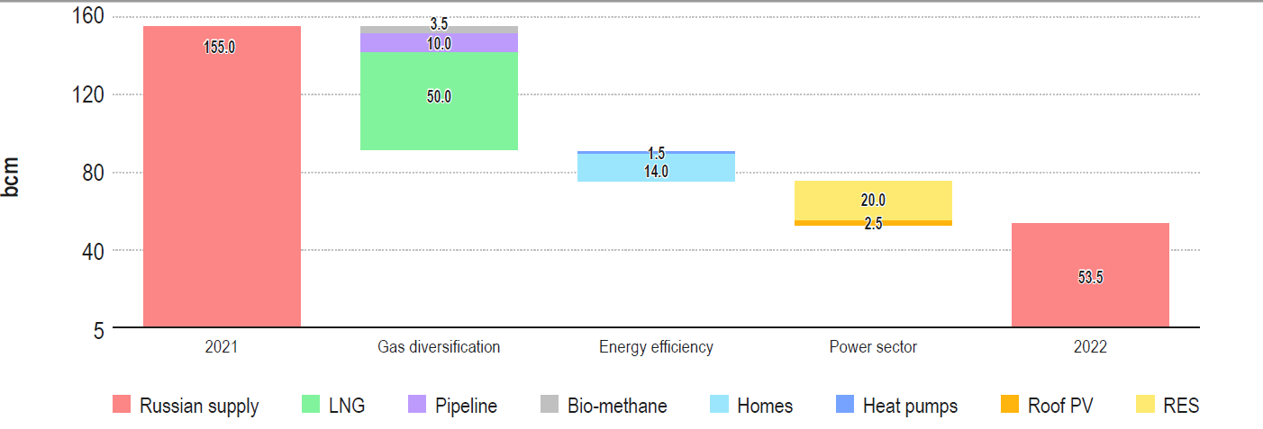
Future LNG needs for the EU are significant
REPowerEU gas supply diversification and Russian supply reduction efforts in 2022 – bcm
REPowerEU targets to replace up to 50 bcm of Russian gas per year via extended procurement of LNG. This is more than 10% of EU 2021 gas demand and ~10% of global 2021 LNG trade.
Source: ACER based on European Commission

Slide 22
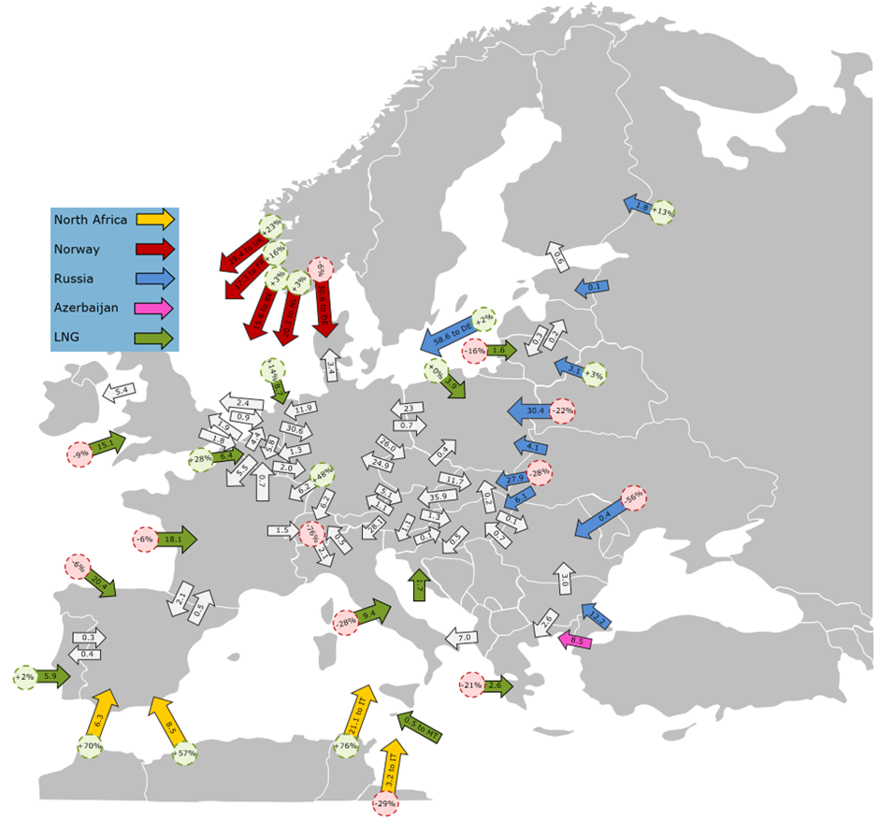
Geography matters: ‘East-to-West’ pipelines dominate
EU and Energy Community countries cross-border gas flows (2021, bcm/year)
The gas system has so far accommodated flows in response to price signals. New emphasis on West to East flows requires new investment.
Source: ACER calculation based on IEA and ENTSOG

Slide 23
Record-high hub price differences are emerging since Q1 2022
Day-ahead price spread between TTF and NBP, TRF and PVB hubs – 2021 June 2022 – euros/MWh
Price differences mainly result from dissimilar LNG deliveries along with cross-border interconnection capacity constraints
Source: ACER calculations based on ICIS Heren and national exchanges.

Slide 24
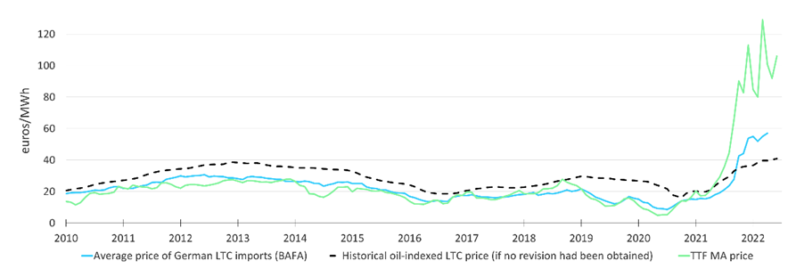
Oil-indexed long-term contracts have become significantly cheaper than hub-priced gas supply
Evolution of selected gas supply price references in the EU, 2010 – June 2022 – euros/MWh
As a result, the welfare gains achieved from the revisions of LTCs into hub-indices have been offset and even turned negative
Source: ACER estimations based on Refinitiv, BAFA, and ICIS Heren

Slide 25
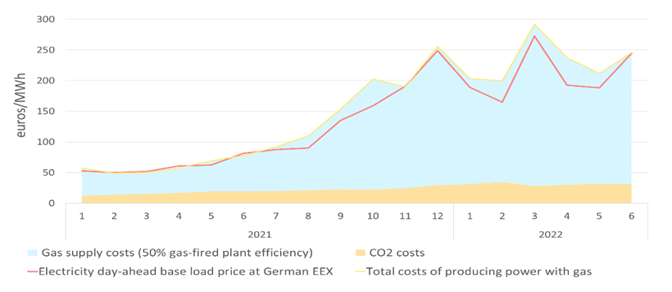
Gas often drives electricity prices
Electricity price development in Germany and breakdown of the costs of producing electricity from gas (May 2021 – June 2022) - (EUR/MWh)
Electricity prices have also reached record-highs, driven by the rise in gas-fired power generation costs, as gas units tend to set the marginal price reference in most EU pay-as-clear power markets
Source: ACER based on ICIS Heren

Slide 26
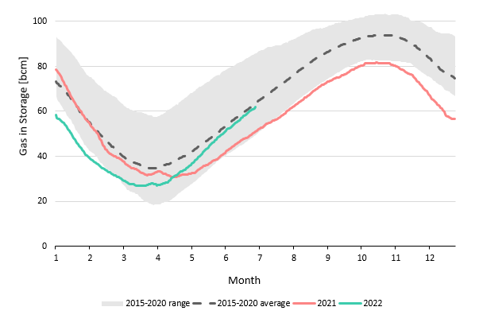
Filling gas storages for upcoming winter is crucial
Evolution of EU storage site levels – 2015 to June 2022 – bcm
Storages filled at ~60% beginning of July, roughly on track to meet the target of 80% by 1 November 2022. Storage remains key for winter resilience.
Source: ACER based on GIE data (excluding Ukrainian and Serbian sites).

