Slide 1
Commercial Quality of DSOs in Austria
Florian Pichler, PhD
26 May, 2021

Slide 2
Framework
Procedures
Results
Challenges

Slide 3
Framework
The three pillars: security of supply, power quality and commerical quality
Commercial quality
Power quality
Security of supply
Reliable energy supply has several dimensions
24/7 energy supply (security of supply)
High-quality energy (power quality)
High-quality customer services (commercial quality)
Commercial quality taps into the properties of the relationships between DSOs and customers, not the product
What does this relationship currently look like?
Do DSOs deliver their services in customer-friendly ways?
How is this relationship to change in the future?

Slide 4
Standards
Meeting requirements in response time, information proviision and punctuality in 95 out 100 cases
Grid use
Grid access
Billing
Discon-nection
Infor-mation
Safety
Appoint-ments
Metering
E-Control is responsible for setting standards and indicators for security, reliability and quality of DSO services; DSOs required to submit annual data
§19 Electricity Act, §30 Gas Act, Electricity and Gas Grid Service Quality Regulations
Multiple dimensions of commercial quality
Requirements for response time
Availability of information
Punctuality

Slide 5
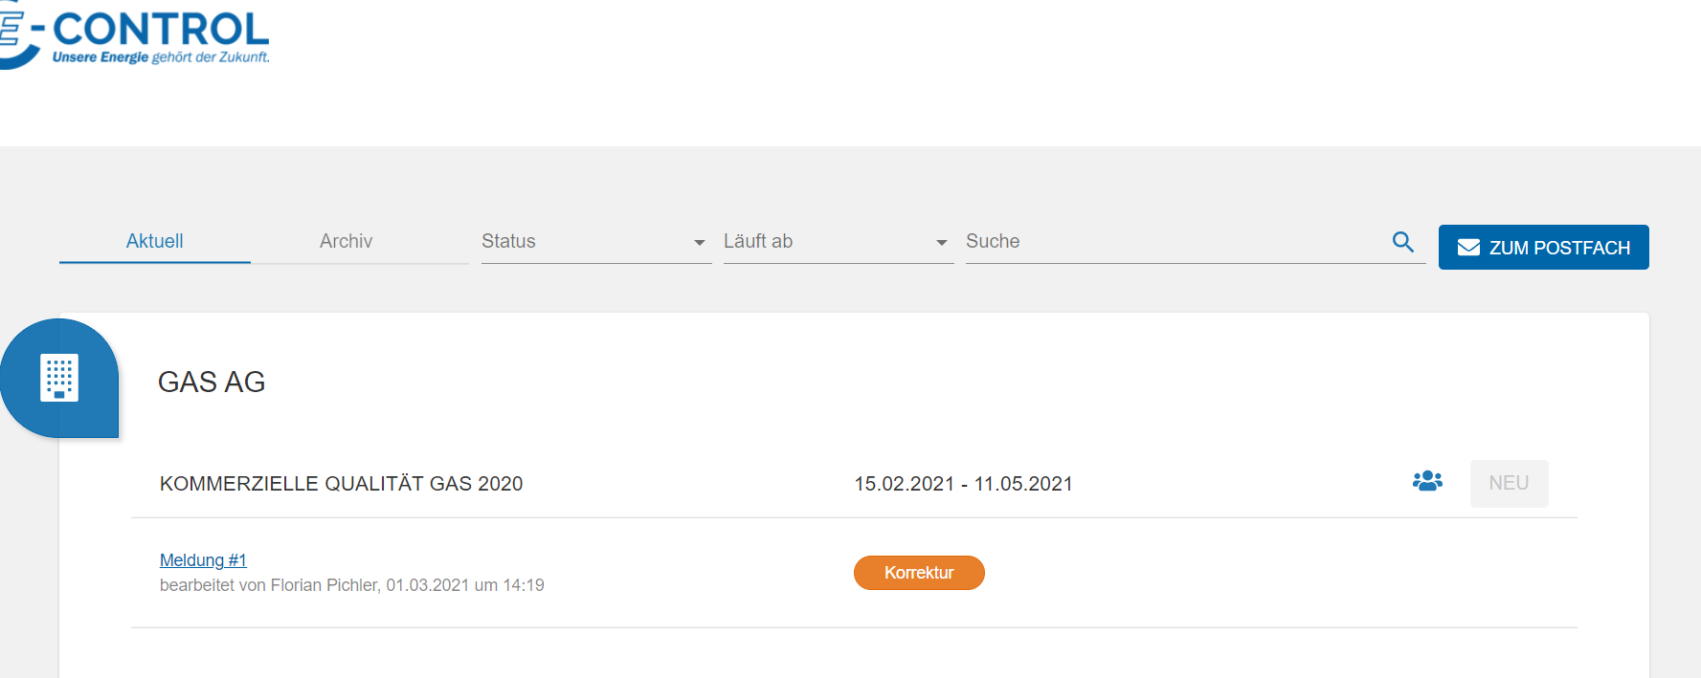
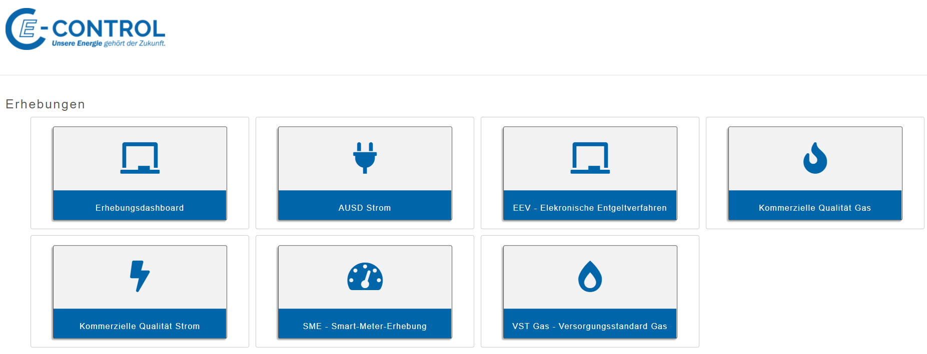
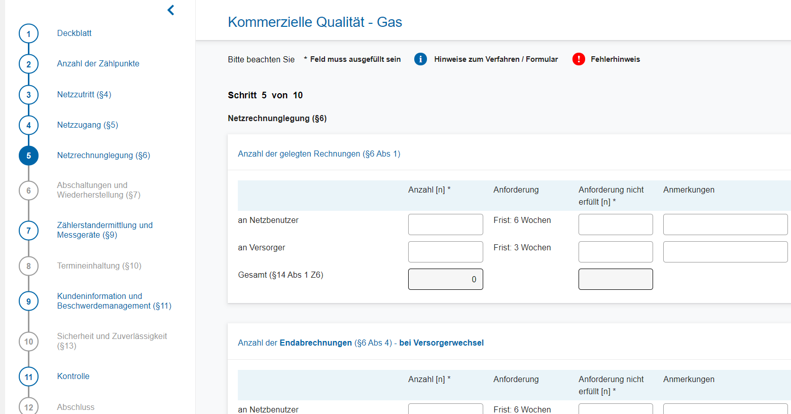
Procedures
IT infrastructure, communication and analysis
Comprehensive IT infrastructure how to design surveys, communicate, handle, analyse and record (archive) data submissions for commercial quality

Slide 6
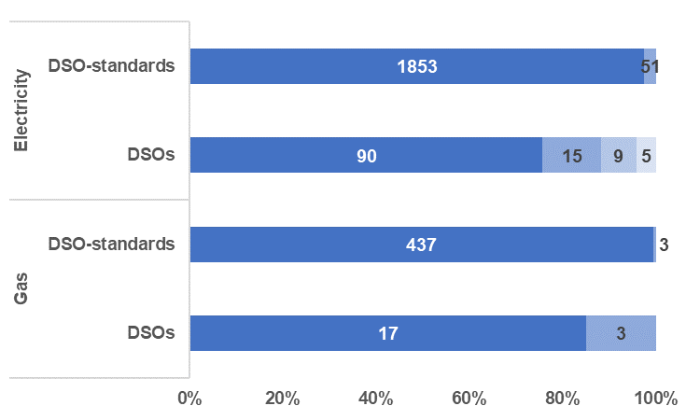
Results
Basic quality standards are (easily) met
Commercial quality is very high in Austria (2019 data)
Electricity
119 DSOs were assessed for compliance with 16 standards each (1904 DSO-standards)
29 DSOs violate a total of 51 standards
90 DSOs violate no standards , 15 violate 1, 9 violate 2 and 5 violate more than 2 (up to 6)
Gas
20 DSOs were assessed for compliance with 22 standards each (440 DSO-standards)
3 DSOs violate a total of 3 standards (1 each)
Compliance with Standards

Slide 7
Challanges
Shifting bonds between DSOs and consumsers?
Relationships between DSOs and customers in a consumer-centric modern energy world?
Too good to be true? Are standards too lax?
What are the relevant relationships in a changing energy world?
Shifting and new roles? New value propositions?
How to best assess their quality?
In what ways do future trends, new business models, the climate emergency, … affect these relationships?
customer
energy community
supplier
service provider
DSO
aggregator

Slide 8
Florian Pichler, PhD
426
Florian.pichler@e-control.at

