Slide 1
Retail Market Developments: Trends in the EU
Deniz Erdem, ACER/CEER Monitoring WS Co-Chair
Jana Haasová, CEER Innovations and Retail Markets WS and CRM WG Co-Chair
3rd Trilateral CEER-ECRB-MEDREG Workshop, 26.05.2021

Slide 2
Content: Selected trends in Europe
Introduction: ACER and CEER activities regarding retail markets
Prices developments in 2019: How much do consumers pay?
Market structure and activities on EU retail markets
Switching rates and available offer types
Innovative Business Models and Consumer Protection Challenges

Slide 3
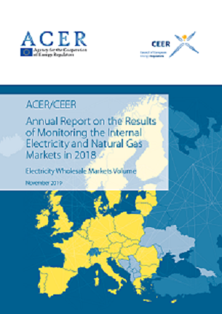
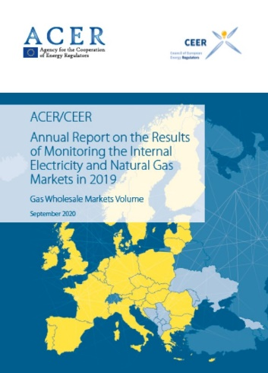
Prices developments in 2019: How much do consumers pay?
Notes:
- Large variations in the electricity price paid by retail consumers are observed across the European Union in 2019
•German household electricity consumers paid the highest price in the EU at 29.8 euro cents/kWh. This is more than three times the price paid by Bulgarian household consumers (9.8 euro cents/kWh)•Greater variations were recorded in the industrial market, with industrial electricity consumers in Denmark paying 22.2 euro cents/kWh in 2019 (the highest in the EU), more than four times higher than the electricity price paid by industrial consumers in Luxembourg in 2019 (the cheapest at a price of 4.9 euro cents/kWh)
•Gas prices increased in 2019 for household consumers but decreased for industrial consumers.
•As with the electricity market, there were variations in the gas markets across the EU in 2019. Household gas consumers in Sweden paid 11.8 euro cents/kWh in 2019, which was almost three times the price paid by household gas consumers in Romania in 2019 (3.4 euro cents/kWh). In the industrial market, gas consumers in Denmark paid almost three times (6.0 euro cents/kWh) the price paid by gas consumers in France (2.1 euro cents/kWh).

Slide 4
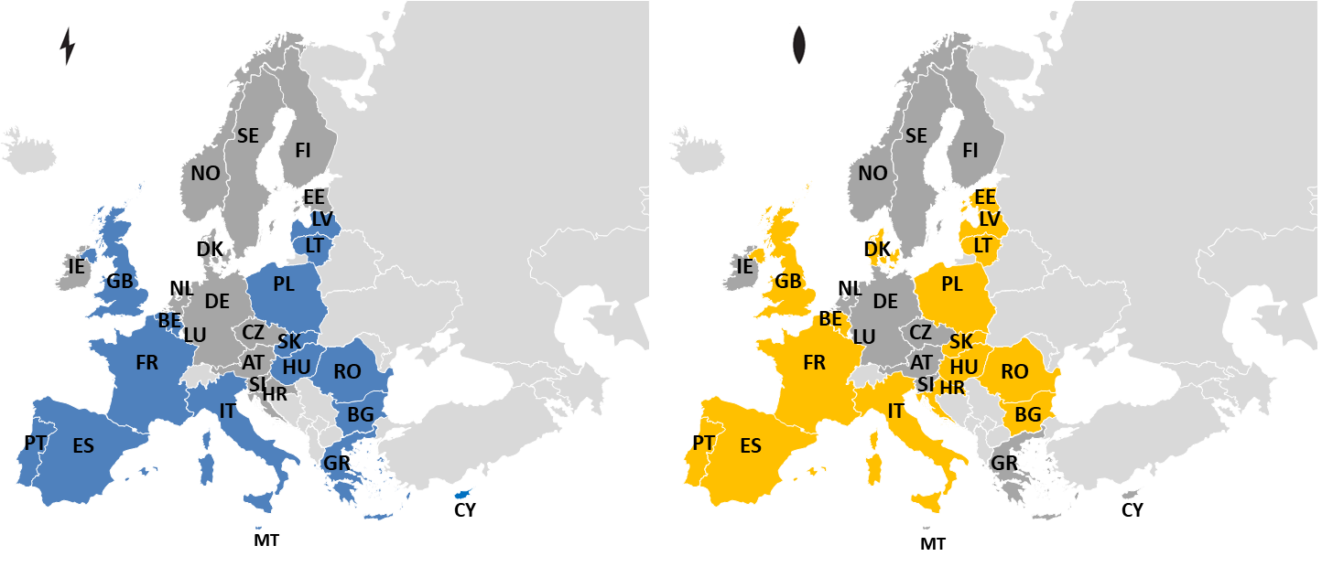
Structures and activities on EU retail markets
EU average number of nationwide suppliers increased in 2019, however there are still major differences among MS.
Market concentration levels improves too slowly, Electricity Markets are performing better than Gas Markets; nHH better than HH
MSs continue to choose different paths towards the liberalisation of the retail markets.
16 MS in electricity (out of 28) and 16 MS in gas (out of 26) have some form of price intervention for households
Notes:
Retail energy market developments are continuing across the EU.
a) The EU average number of nationwide suppliers increased in 2019, however there are still major differ-ences among Member States. While in some Member States there are very few suppliers at all, in others the suppliers mainly operate on a regional level.
b) Market concentration and Herfindahl-Hirschman Index (HHI)9 levels are still improving too slowly in Eu-rope. While electricity markets are performing better than gas markets in this respect, the non-house-hold/industrial segment is less concentrated than the household segment. A less concentrated market may impact the level of competition in a particular market.
c) Member States continue to choose different paths towards the liberalisation of retail markets. Price inter-vention in both gas and electricity continues to exist in some Member States. 80% of the Member States reported that the reason for public price intervention in the price setting is the protection of consumers against price increases. Figure i outlines the current status of price intervention in the EU.

Slide 5
Switching rates and offers
Some MSs recorded very high ext. switching rates over the past years while the rates for the MS with regulated prices below costs are usually low
Highest external switching rates (of 20%) were recorded in GB, NO, and BE for electricity and in NL, BE and GB for gas markets.
Compared to household consumers, switching rates of non-households are usually higher
Notes:
A general decline is observed regarding the availability of certain offer types in electricity across MS in 2019. This may be due to some missing data for 2019 of a few MSs where respective products were available. Nevertheless, the picture remains the same if it comes to the availability of fixed, variable, online and green tariffs. They are still the most available products on the European electricity markets. It should be noted that consumers in more MSs had access to online offers in 2018 and 2019 compared to 2017. The number of products such as different pricing options and guaranteeing the origin increased from 2017 to 2019. The trend to online offers with origin guarantee can be interpreted that there is an increasing demand and hence economic and environmental awareness of electricity consumers and consequently companies offer more online products.194 Some positive changes have been observed in the gas sector when it comes to the offer type availability in the MSs. Ten offer types are available in more MSs in 2019 than were available in 2018. A major increase has been recorded in social offers, which has been available in two MSs in 2018 and were available in eight MSs in 2019. In addition, some MSs reported the introduction of offers with monetary gains or additional service and different pricing options on their markets.

Slide 6
Innovative Business Models and Consumer Protection Challenges
Publication of the report is foreseen in July
Phase I: Consultancy CEPA
Case studies on:
Peer-to Peer Facilitators
Engagement Enablers
Energy as a Service
Network Optimisation
E-mobility
Phase II: CEER Project team working on identified regulatory issues:
New entrant access
Consumer choice and the Principal-Agent problem
Self-consumption
Data access and protection

Slide 7
Innovative Business Models and Consumer Protection Challenges – preliminary conclusions
New entrant access
Ensure fair data access to every stakeholder
Encourage interoperability between equipment
Simplify market rules to enable small-scaled asset to participate
Consumer choice and the Principal-Agent problem
Consumer captivity
Inequality due to differences in consumer skills and financial means
Adequate regulation of agents
Self-consumption
Integration into balancing rules
Adaptation of retail market monitoring
Define responsibility of sharing of production amongst collective self-consumers
Data access and protection
Ensure cybersecurity remains a key priority
Further empowerment and customization to fit the type of consumer
Close oversight cooperation with regulators from other sectors
Notes:
New entrant access
- Encourage interoperability between equipment: To prevent incumbents to lock in the market via non-interoperable equipment, equipment interoperability should be encouraged, or even mandatory.
Simplify market rules: To benefit from the full potential of demand-side management and EVs development, it is necessary to adapt rules regulating actor’s participation in flexibility markets. Certification processes may be too heavy for small, distributed generation, and performance controls are not always adapted to the consumption patterns of EVs. Lessons learnt from regulatory sandboxes are valuable both for regulators and innovators.
Consumer choice:
Captivity: The challenge for regulators regarding consumer captivity is to overcome perverse contract effects, while enabling innovative business to successfully grow. Regulators should try to find ways to diminish lock-in effects of certain contracts, for example by enforcing businesses opening up the product for third-party access or taking measures to reduce the risk on high pricing or poor quality.
- Inequality: Regulators must ensure that energy consumers are adequately informed about new technologies and basic financial concepts, and / or that information is presented to consumers in as clear and simple a manner as possible in order that the consumer is able to make an informed choice. Particularly the case of bundled products.
Adequate regulation of agents: This may not in all cases necessarily lie within the remit of the NRA for energy, and may be more appropriately placed within the remit of the consumer competition authority (or similar).
Self-consumption:
Integration into balancing rules: Those regarding independent aggregators in order to clearly define delimitation of balancing responsibilities.
Adaptation of MMR: In order to better understand the impact of self-consumption in market dynamics, namely on offers, prices and switching rates involving self-consumers.
¨- Define responsibility: With the aim to easily solve conflicts in the case of dispute resolution.
Data access and protection:
Ensure cybersecurity remains a key priority: Possibly in close collaboration with experts from outside the energy sector . As yet more actors become involved in data handling and more devices are smart and connected, the system will be exposed to ever-increasing vulnerability.

Slide 8
Thank you for your attention!
www.ceer.eu

