Slide 1
Solare Prosumer
Prosumers in Germany
Sandra Hannappel, Bundesnetzagentur
3rd Trilateral CEER-RCRB-MEDREG Workshop, 27.05.2021

Slide 2
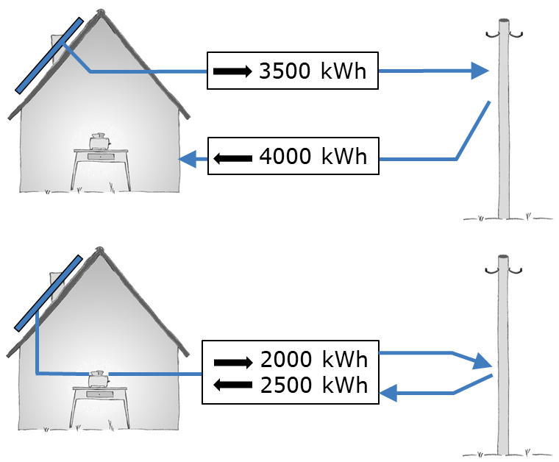
Integration of Prosumers in Germany
Electricity produced by prosumers is relevant:
More than two million PV systems have already been installed. About one million of those are being used for self-consumption and more than 220.000 electricity storage units exist.
At times (e.g. noon time in summer), more than 25 % of total electricity consumption is generated by PV systems that are connected to the low voltage grid.
Prosumers in Germany usually choose between two options:
1. Full feed-in (no self-consumption)
2. Self-consumption in combination with feeding surplus electricity into the grid
Prosumers are not fully integrated into the electricity market:
Consumption and generation are usually not measured on a quarter-hourly basis.
The supply of electricity taken from the grid is provided by using a standard load profile.

Slide 3
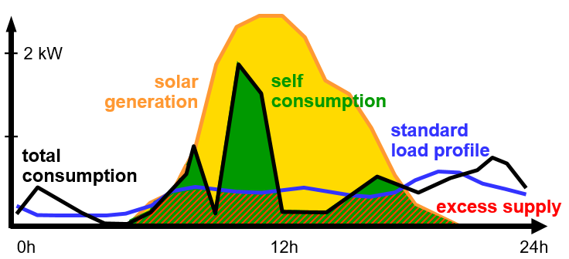
Effects of partial market integration
Partial integration of prosumers into the electricity market leads to unintended effects:
Prosumers who consume self-produced
electricity are simultaneously supplied by
their suppliers, leading to excess
supply in the system.
Insufficient electricity balancing can result
in network security risks.
Prosumers cannot react to price volatility, actively participate on wholesale markets, or provide flexibilities.
Active participation of prosumers in the electricity market requires the assumption of responsibility:
Electricity fed into the grid as well as electricity drawn form the grid must be measured on a quarter-hourly basis.
No application of standard load profiles in combination with self-consumption.

Slide 4
Contact
Sandra Hannappel Referat für erneuerbare Energien Bundesnetzagentur
+49 228 14-6469 sandra.hannappel@bnetza.de

