Slide 1
3rd Trilateral CEER-ECRB-MEDREG Workshop CEER COVID-19 WG: Analysis of the COVID-19 pandemic’s effects on the energy sector
Jean-Laurent Lastelle 26 May 2021

Slide 2
COVID-19 Interim Report
Objectives
Mapping the effects of the COVID-19 pandemic on the electricity and gas systems, consumers and energy companies in CEER countries;
Identifying a first set of lessons learned and best practices from 2020.
Approach and data collection
Questionnaire on the effects of the pandemic on the energy system as a whole, consumers, energy suppliers and network operators;
28 NRAs provided input: Austria, Belgium, Bulgaria, Croatia, Czech Republic, Estonia, Finland, France, Georgia, Germany, Great Britain, Greece, Hungary, Ireland, Italy, Latvia, Lithuania, Luxembourg, Malta, the Netherlands, North Macedonia, Norway, Portugal, Romania, Slovakia, Slovenia, Spain, Sweden;
Comparing the results of that exercise with findings from other institutions (IEA, OECD, EC, ACER/CEER).

Slide 3
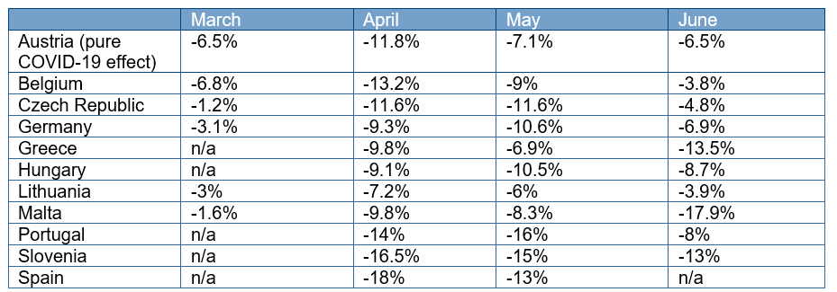
Impact on the electricity and gas systems 1/2
Electricity
Demand and prices fell markedly over the spring months 2020 that coincided with restriction measures, such as lockdowns.
E.g.: fall in global electricity consumption per month in March-June 2020 in selected countries, compared to the same month of 2019.

Slide 4
Impact on the electricity and gas systems 2/2
Electricity (continued)
As regards prices, the COVID-19 pandemic was one of the causes, but not the only cause. Depending on the country, other factors were at play (e.g. weather conditions).
Second wave restrictions (winter 2020) seem to have had less of an impact than first wave restrictions (spring 2020).
Renewable energy sources (RES): Several countries saw an increase in the RES share of their electricity mix, which the system was able to handle.
Gas
Demand and prices were already low in Q1 2020, but reached new lows concomitantly with restrictions.
Gas trends varied more widely over all respondent countries, again due to other factors, such as weather conditions.

Slide 5
Impact on energy consumers
Risk for consumers
Restrictions entailed business closures, income and even job losses.
Risk of inability to pay energy bills and of losing energy supply.
Types of measures put in place to support consumers
Moratorium on disconnections: the most widespread measure (reported by 18 NRAs);
Staggering or deferral of consumer energy bills;
Social welfare measures: mostly not specific to energy expenditure;
But: in some countries, direct subsidies for energy costs, fuel vouchers (Great Britain, Ireland), facilitated access to social tariffs (Italy, Spain), excise duty reduction on electricity and gas (Estonia);
Aid for businesses: mostly not linked to energy supply;
But: in some countries, suspension or reduction of contracted capacity (Ireland, Portugal, Spain), energy bill refund (Malta), deferred payments for utilities (Romania).

Slide 6
Impact on energy companies
Energy suppliers
Mirror image of disconnection bans: several NRAs reported or expected an increase in unpaid energy bills.
Suppliers reported losses due to drops in electricity demand and prices.
Measure taken to support suppliers in some countries: staggering and deferral of network tariff bills.
Network operators
Lockdown measures entailed delays to network development and smart-meter roll-out.
Some NRAs already anticipated / reported a slight decrease in tariff revenue.
At the time of writing, the majority of NRAs had not yet taken any measures to support network operators.
In some countries: easing of quality of service obligations and penalties, consideration for pandemic-related costs.

Slide 7
Lessons learned & best practices
Resilience of the energy sector;
Ireland: some generation units set aside to ensure availability in winter;
Ensuring good and swift information flows;
Finland: centralized task force including all relevant parties;
Adapting procedures and deadlines where necessary;
Germany: legislation adopted to adapt deadlines and enable digital solutions in planning and approval procedures;
Key measure: preventing disconnections of consumers;
Spain, Lithuania, Portugal: possibly the most impactful measure;
Sharing the burden more widely within the sector;
Italy: for suppliers, partial suspension of tariff bills and ad hoc financing.
Remote operations and digitalisation;
Luxembourg: restrictions have pushed digitalisation efforts ahead.

Slide 8
Thank you for your attention!
www.ceer.eu

