Slide 1
Prosumers and active self-consumption: Funding opportunities, incentive structures and pick-up of self-generation and (surplus) injection/selling into the grid The case of Mediterranean country: Lebanon

Slide 2
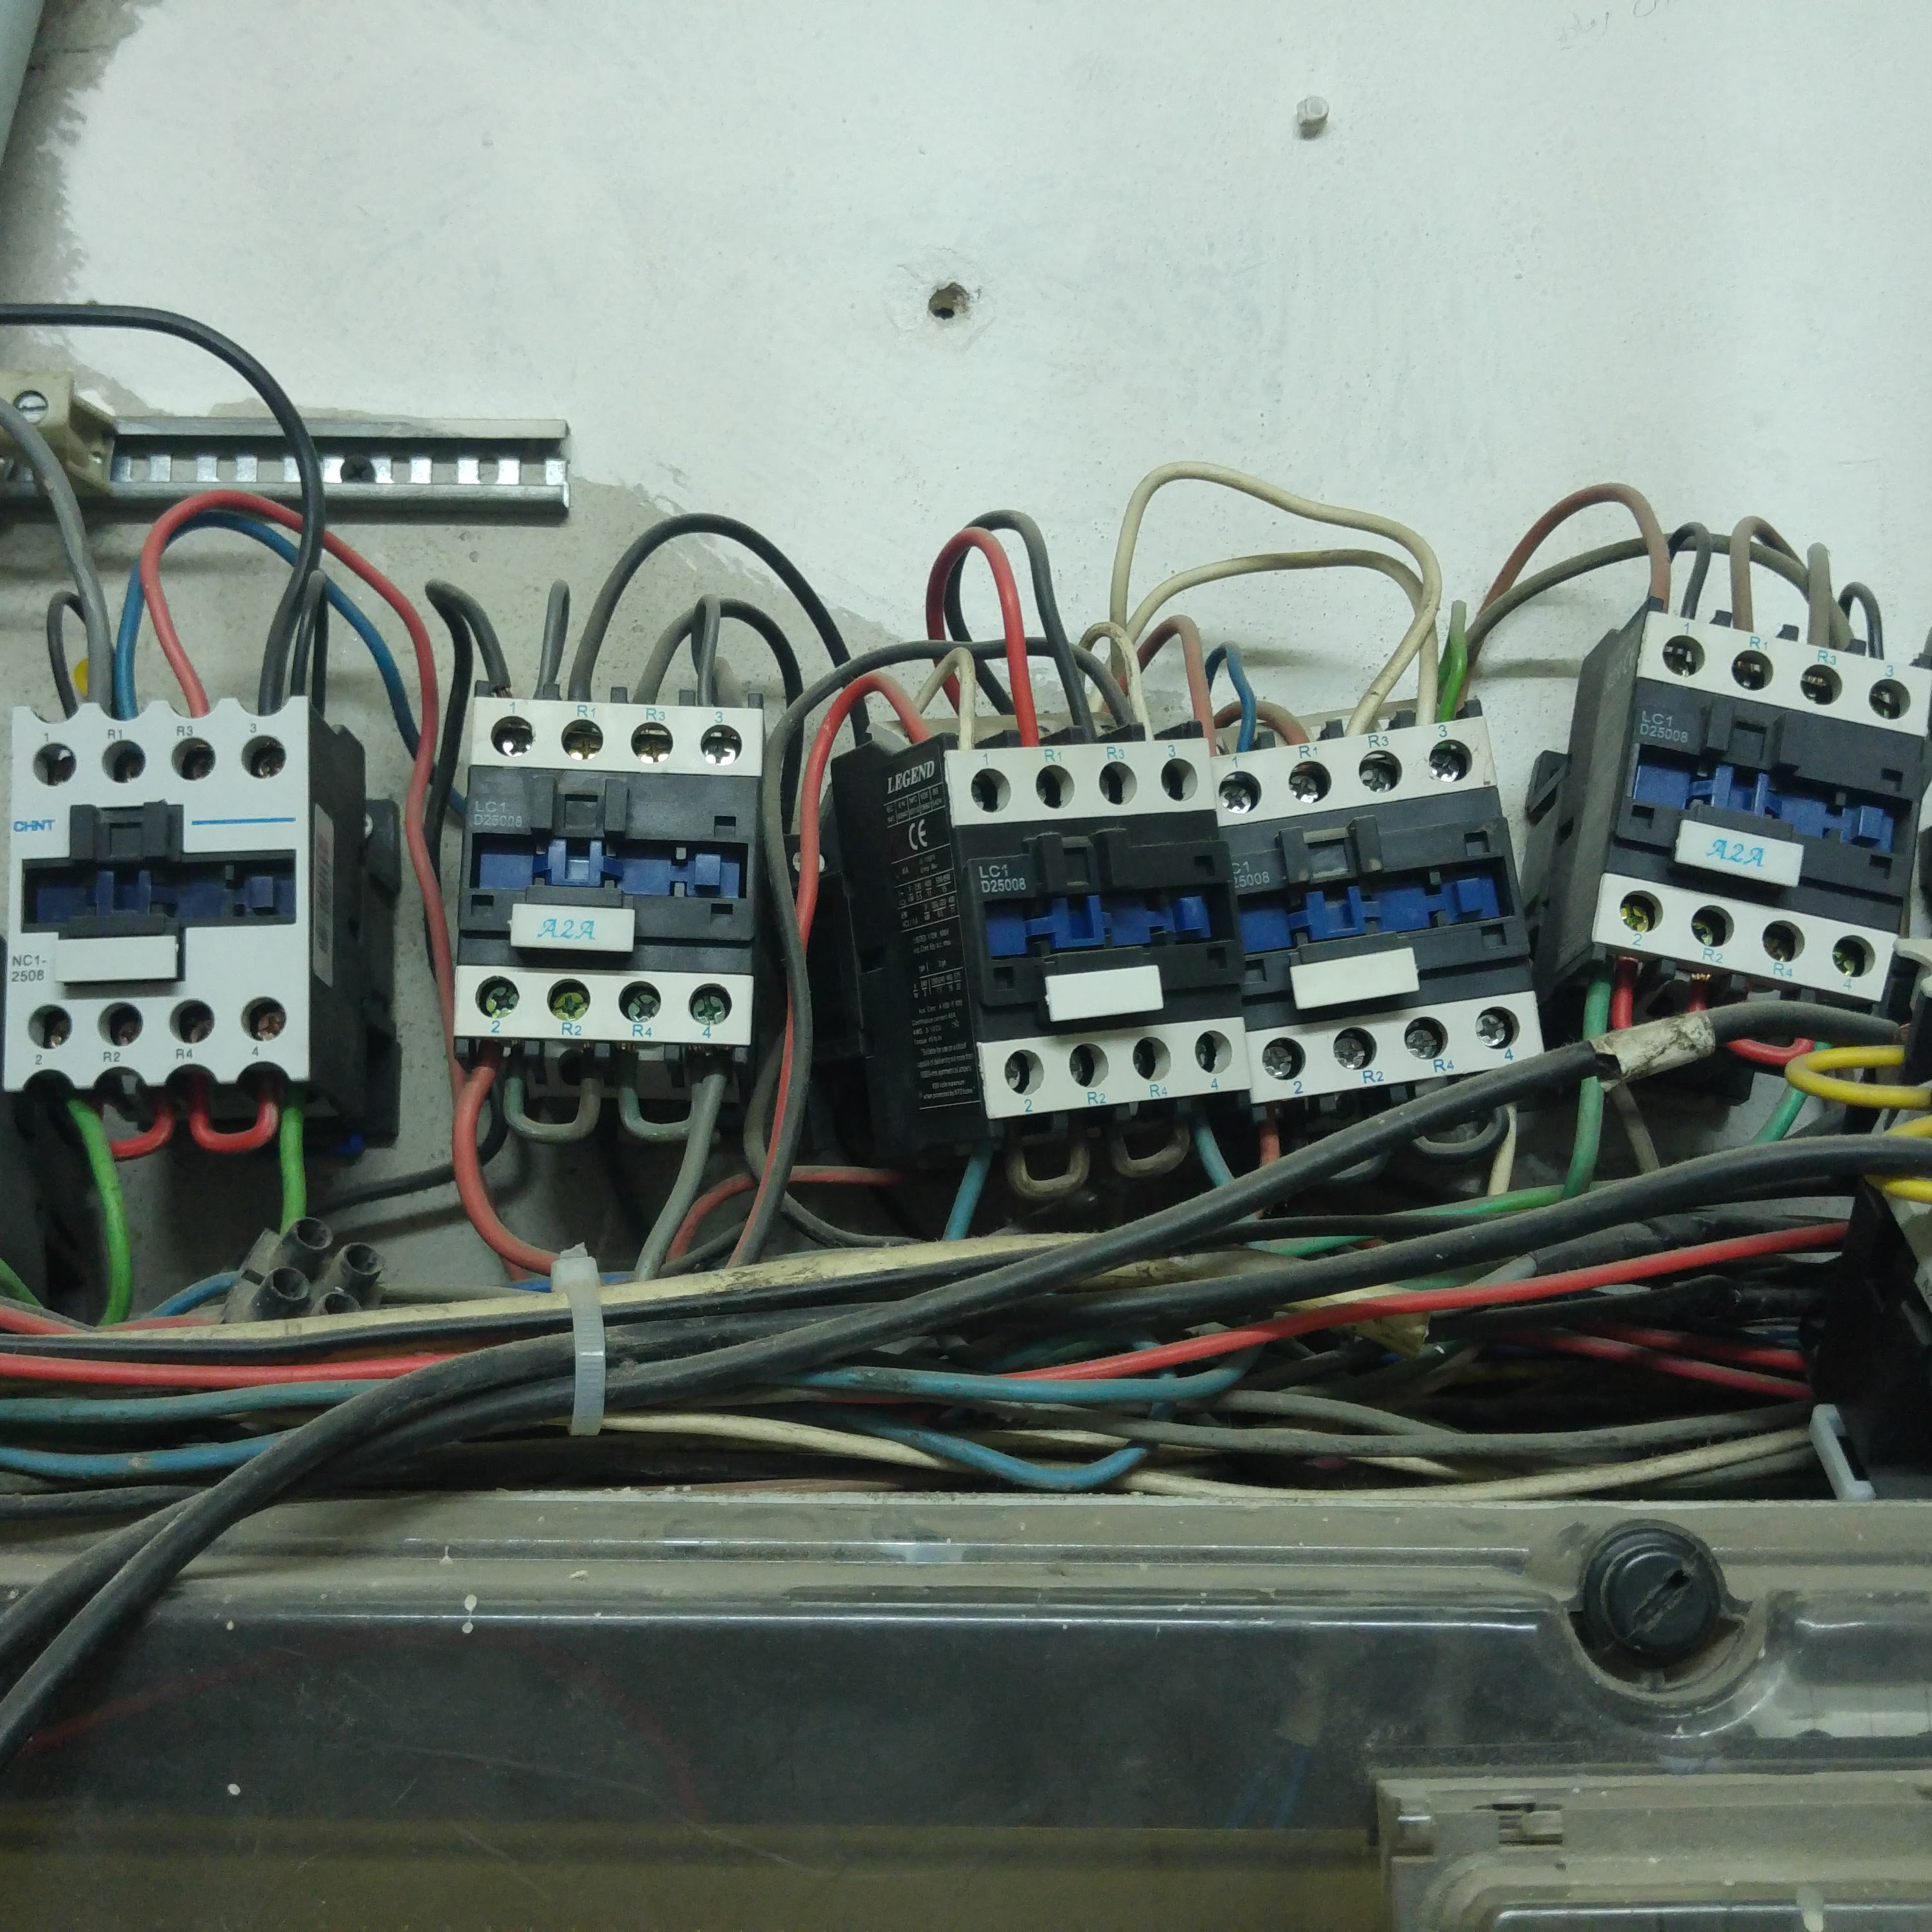
Legal Framework: self-generation
Law N° 462 of 2/9/2002 “Regulation of the Electricity Sector” – Article 26 allows self generation:
“generation equipment intended for private use with power less than 1.5 MW shall not be subject to the Authorization condition, provided that environmental, public health, and public safety standards are complied with, and based on specific standards issues by the Authority after consulting the opinion of the Ministry of Environment and concerned administrations and institutions”;
Generation equipment intended for private use with power exceeding 1.5 MW is subject to an Authorization by the Authority.
Ministry of Environment memos 10 of 19/3/2011 and 11 of 29/7/2013 set minimum environmental standards for private generation facilities, mainly related to air pollution, noise pollution, liquid waste (oil and grease from maintenance), solid waste (tools, equipment and replacement parts), and ozone-friendly fire extinguishers.
The Authority is not formed yet.
No mention of modalities for connection of self-generation equipment/systems with the grid.

Slide 3
Lebanese Electricity Sector: challenges and role of self-generation
More than 96% of primary energy is imported.
Significant tariff subsidies with a highly burden on the national budget.
Significant gap between electricity demand and supply.
Gap is covered by self-generation:
Private individual diesel generators (legal if power less than 1.5 MW and if Ministry of Environment’s minimum environmental standards are complied with.
Neighborhood-level diesel generators (informal).
Distribution of neighborhood-level generated electricity is done through informal networks (not connected to the national grid).

Slide 4
Policy Framework: Distributed Solar PV self-generation
2019
Updated Policy Paper for the electricity sector: 30% RE of the total elec. consumed in 2030
500 MW Distributed Solar PV (DPV) self-generation by 2030.
2021 National Renewable Efficiency Action Plan (NREAP 2021-2025): DPV target for 2025
2020 Lebanon Renewable Energy Outlook for 2030: 500 MW DPV by 2030
2018 Prime Minister declaration: 30% RE by 2030
National Renewable Efficiency Action Plan (NREAP 2016-2020) – 100 MW DPV by 2020
2016
COP 15 commitment: 12% RE in the energy mix by 2020
2009
Policy Paper for the Electricity Sector: 12% RE in the energy mix by 2020 2010
National Energy Efficiency Action Plan (NEEAP 2011-2015)
2011
Launch of the net metering scheme 2011
Launch of the National Energy Efficiency and Renewable Energy Action (NEEREA financing) 2012

Slide 5
Policy Framework: Distributed Solar PV self-generation
2019
Updated Policy Paper for the electricity sector: 30% RE of the total elec. consumed in 2030
500 MW Distributed Solar PV (DPV) self-generation by 2030.
2021 National Renewable Efficiency Action Plan (NREAP 2021-2025): DPV target for 2025
2020 Lebanon Renewable Energy Outlook for 2030: 500 MW DPV by 2030
2018 Prime Minister declaration: 30% RE by 2030
National Renewable Efficiency Action Plan (NREAP 2016-2020) – 100 MW DPV by 2020
2016
COP 15 commitment: 12% RE in the energy mix by 2020
2009
Policy Paper for the Electricity Sector: 12% RE in the energy mix by 2020 2010
National Energy Efficiency Action Plan (NEEAP 2011-2015)
2011
Launch of the net metering scheme 2011
Launch of the National Energy Efficiency and Renewable Energy Action (NEEREA financing) 2012

Slide 6
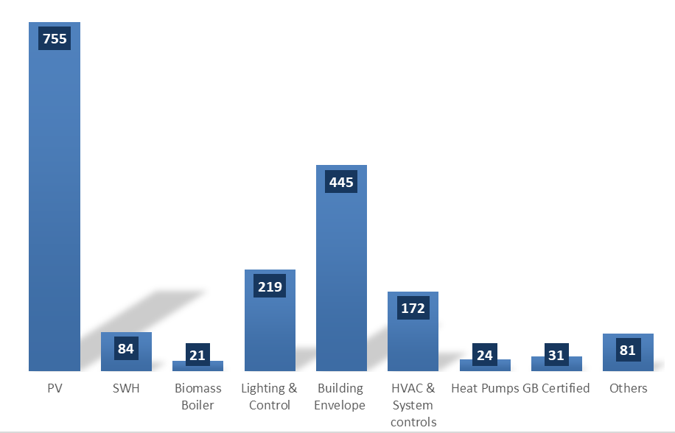
NEEREA Fiancing Mechanism
Low-interest financing over a long repayment period through the commercial banks.
Launched and supported by the Central Bank of Lebanon (BDL).
^{Technical assistance by LCEC.}
Around 1,000 projects were approved by June 2020 (more than 1,800 energy efficiency and renewable energy measures).
More than 600 Million USD invested between 2012 and 2020 (101 Million USD in solar PV projects).
76% of the number of projects are solar PV.

Slide 7
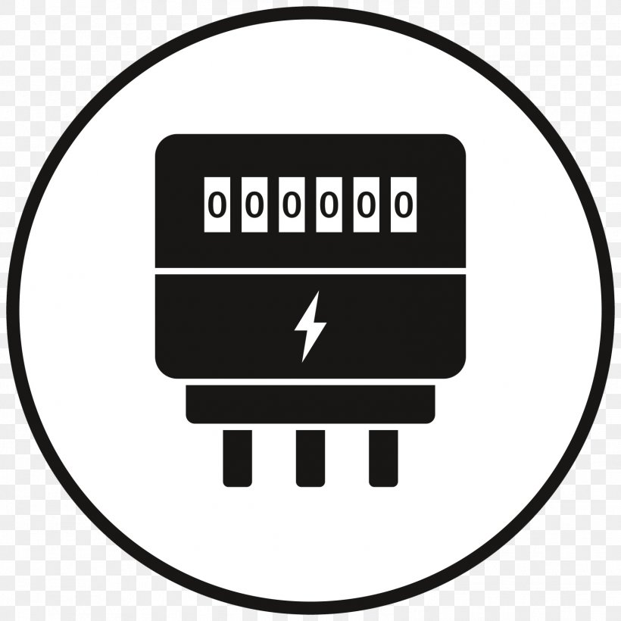
Net metering Scheme
Aimed for consumers to be able connect their on-site renewable energy systems, with the main purposes of satisfying their local demand for electricity, and wishing to export any excess to the grid.
Approval is subject to compliance with the required technical standards, and safety requirements (checklist is publicly available with the application form).
Consumer is able to export generated renewable electricity when the demand is low, and reduce the imported electricity, when the on-site demand is high, thus maximizing the value of the renewable energy sources.
Any excess electricity fed to the grid by the renewable energy system will be deducted from the utility bill that is issued every two months.
If a producer/consumer exports renewable electricity more than his/her total electricity consumption in any given billing period, then the excess balance is transferred and credited to the next billing period.
This process happens over 1 year (January to December), where at the end of the year the meter will be reset again to zero.
One can apply to a net meter by filling in the net metering application and uploading all the needed documentation online.
Around 865 net meters are installed and operational with a total Solar PV capacity of more than 21.5 MW, including residential, commercial, and industrial customers.

Slide 8
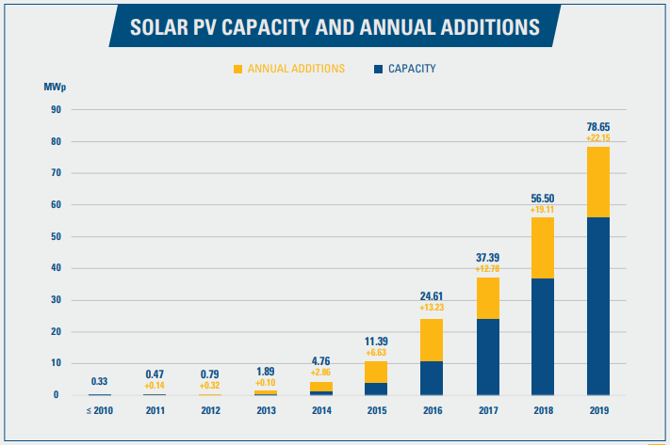
Impact: the Distributed Solar PV self-generation sector
Constant increase in solar PV installations.
Source: The 2019 Solar PV Status Report for Lebanon (https://lcec.org.lb/our-work/lcec/solarpvreport)

Slide 9
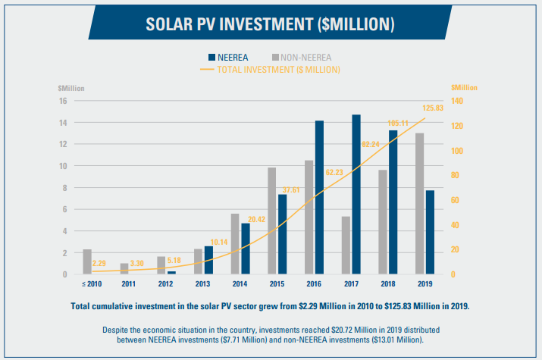
Impact: the Distributed Solar PV self-generation sector
Constant increase in solar PV installations.
Constant increase in total investments in the sector.
Source: The 2019 Solar PV Status Report for Lebanon (https://lcec.org.lb/our-work/lcec/solarpvreport)

Slide 10
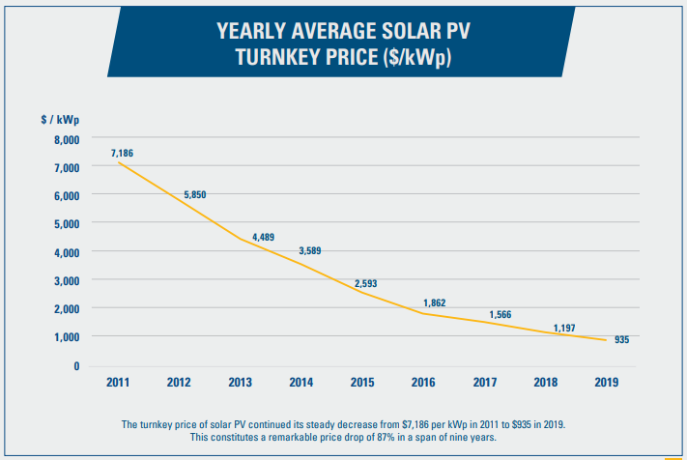
Impact: the Distributed Solar PV self-generation sector
Constant increase in solar PV installations.
Constant increase in total investments in the sector.
Constant reduction in turnkey price.
Source: The 2019 Solar PV Status Report for Lebanon (https://lcec.org.lb/our-work/lcec/solarpvreport)

Slide 11
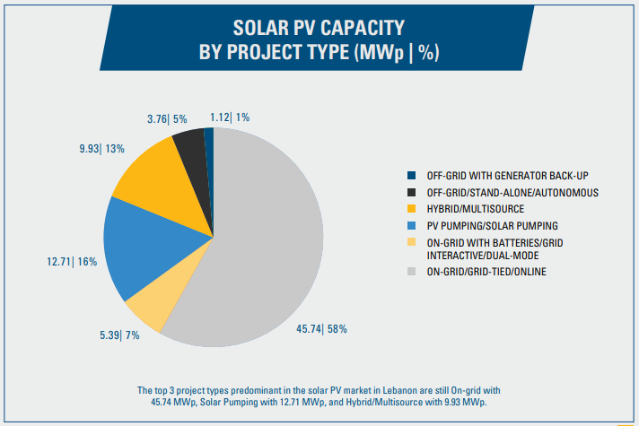
Impact: the Distributed Solar PV self-generation sector
Constant increase of solar PV installations.
Constant increase in total investments in the sector.
Constant reduction in turnkey price.
More than 65% of the solar PV installations are connected to the grid.
Source: The 2019 Solar PV Status Report for Lebanon (https://lcec.org.lb/our-work/lcec/solarpvreport)

Slide 12
Via Fieno, 3 20123 Milan | Italy www.medreg-regulators.org
MEDREG

